Slide 1


Spatiotemporal Analysis of Forest Cover Change and Hot Spot Detection in the Quabbin Reservoir Watershed Forest, Massachusetts
Mst Sanjida Alam
Pacifique Madibi

Slide 2
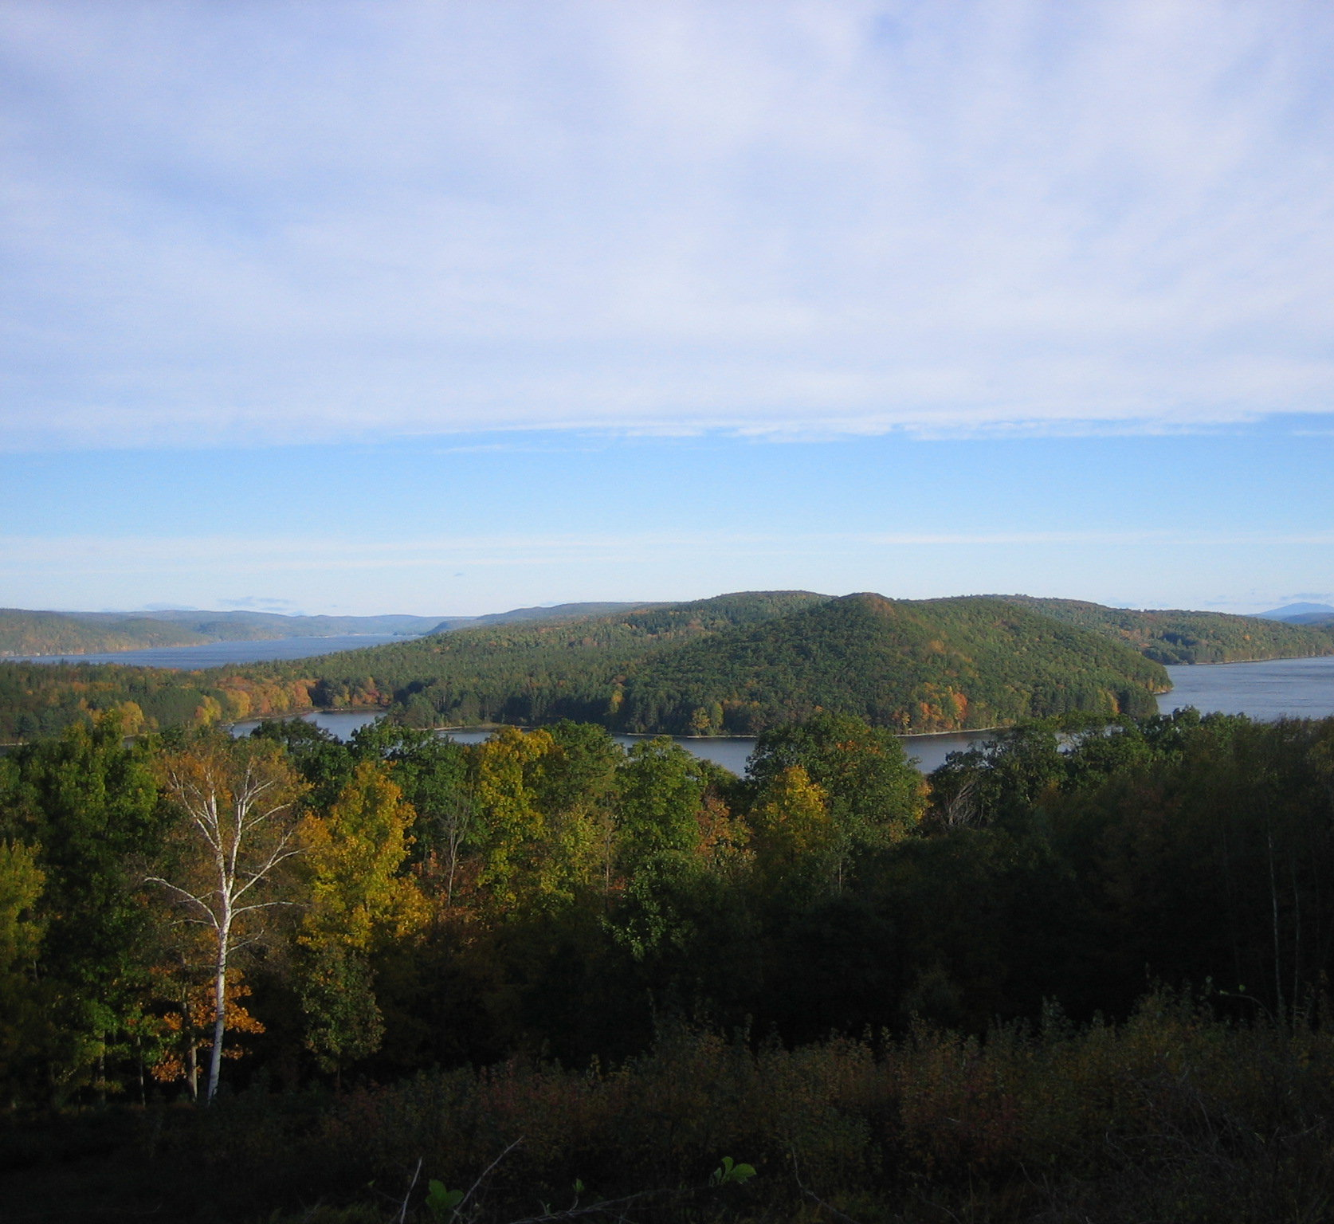
Introduction
The long-term effectiveness of conservation efforts in protected forest areas depends on the ability to monitor and evaluate patterns of landscape change across time and space.
Methodologies such as Emerging Hot Spot Analysis (EHSA) have been successfully applied to identify conservation priorities in tropical regions (Cuba et. Al., 2022), their use in temperate regions remains limited.
This study aims to analyze the trends of Quabbin Reservoir Watershed Forest cover change from 2000 to 2023 using satellite-based datasets.

Slide 3
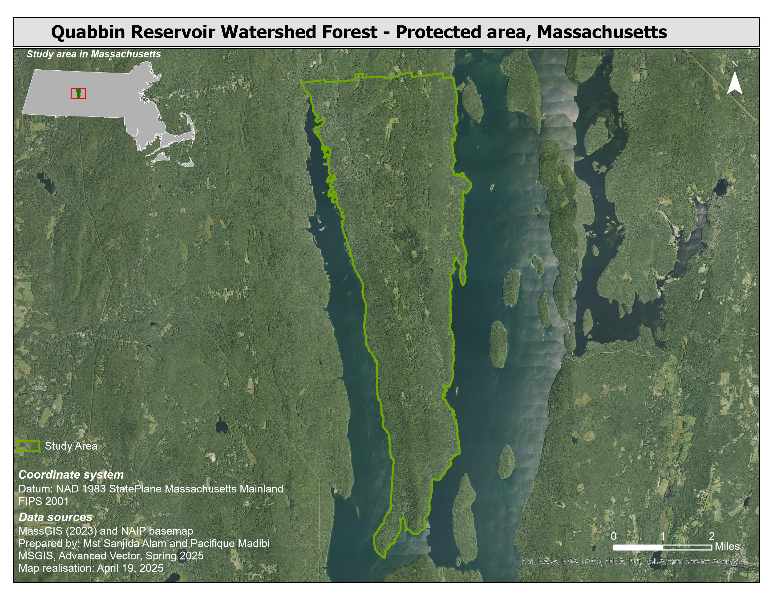
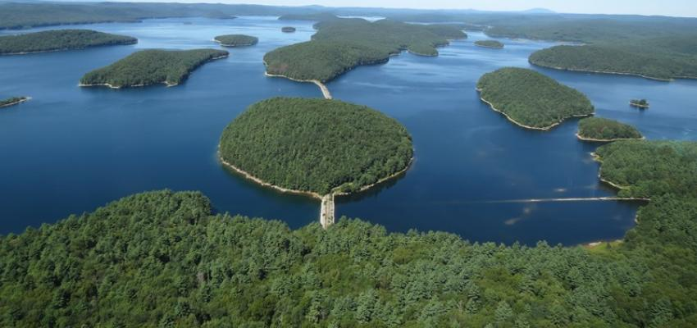
Study Area
The Quabbin Reservoir Watershed Forest (46.62 sq km), located in central Massachusetts, is the state’s largest inland protected watershed, serving as the primary drinking water source for over 3 million people in the Greater Boston area.
Rich biodiversity and extensive forest cover that plays a vital role in ecosystem services and water quality protection (DCR, 2023).

Slide 4
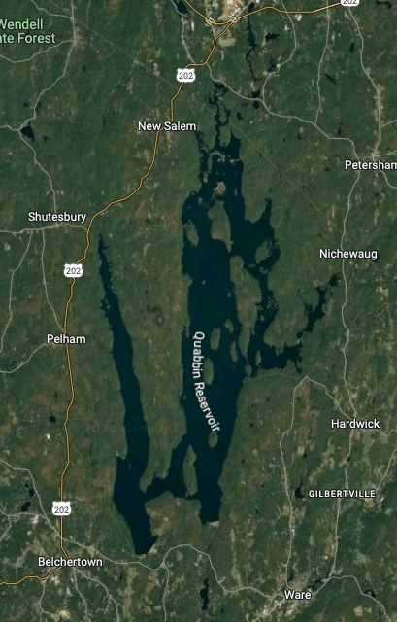
Objectives
To quantify and map forest loss and gain within the Quabbin Reservoir Watershed Forest from 2000 to 2023 using Global Forest Change data.
To detect spatial clusters and emerging hot spots of forest change.

Slide 5
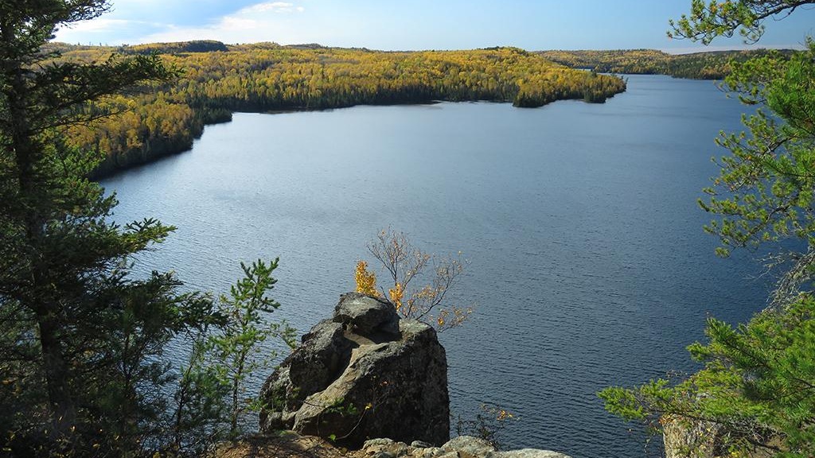
Research Question
How have patterns of forest loss and gain changed spatially and temporally within the Quabbin Reservoir Watershed Forest over the last two decades, and where are the statistically significant clusters of change located?

Slide 6
Data used
Dataset | Source | Resolution / Scale | Time Period | Purpose
Global Forest Change | Hansen et al., 2013; GLAD Lab, UMD | Raster (30 meters) | 2000–2023 for loss and 2000-2012 for gain | Forest loss/gain trend analysis
Quabbin Watershed Boundary | MassGIS (Open Space) | Vector (shapefile) | 2023 | Study area boundary delineation

Slide 7
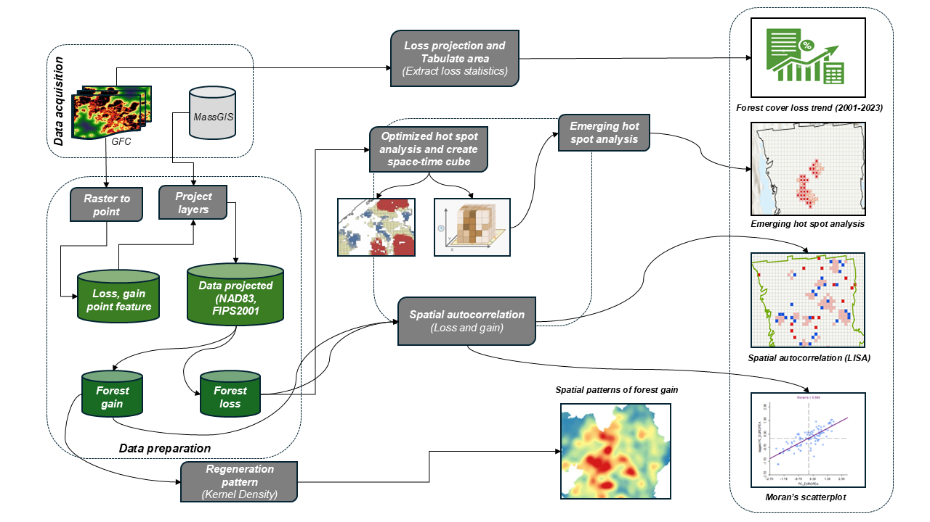
Workflow

Slide 8
Results

Slide 9
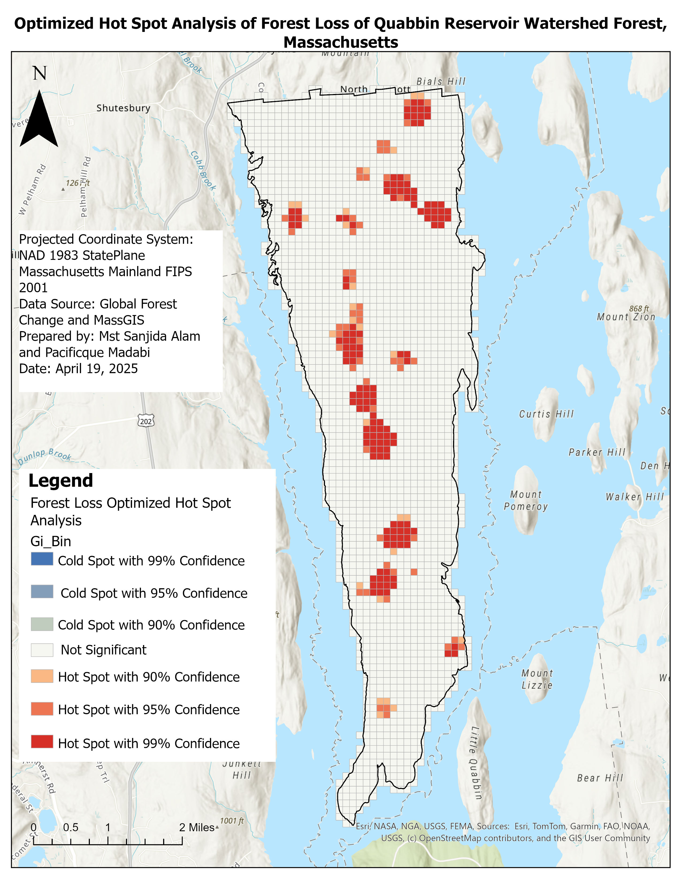
Optimized Hot Spot Analysis of Forest Loss
Most hot spots are concentrated in the central, northeastern and southern portions, suggesting these areas have experienced intensive and spatially clustered deforestation over the 23-year period.
No cold spots were identified, indicating a general trend of either active loss or neutral change across the watershed.

Slide 10
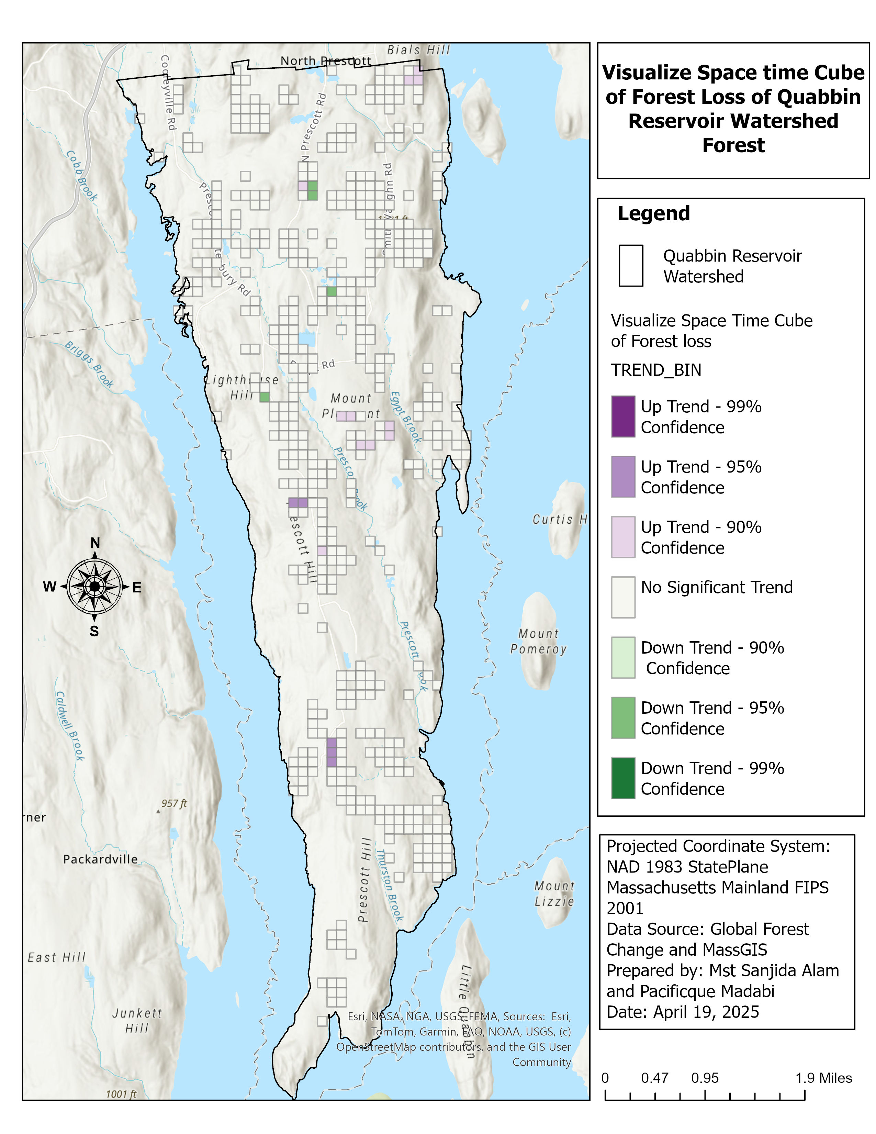
Visualize Space time Cube of Forest Loss
Upward Trends (Purple Shades) indicate areas where forest loss is increasing over time, with confidence levels ranging from 90% to 99%.
Downward Trends (Green Shades) Highlight areas where forest loss is decreasing.
Forest loss is not uniformly distributed but concentrated in select areas, particularly in the central, northeastern and some part of southern zones of the watershed.

Slide 11
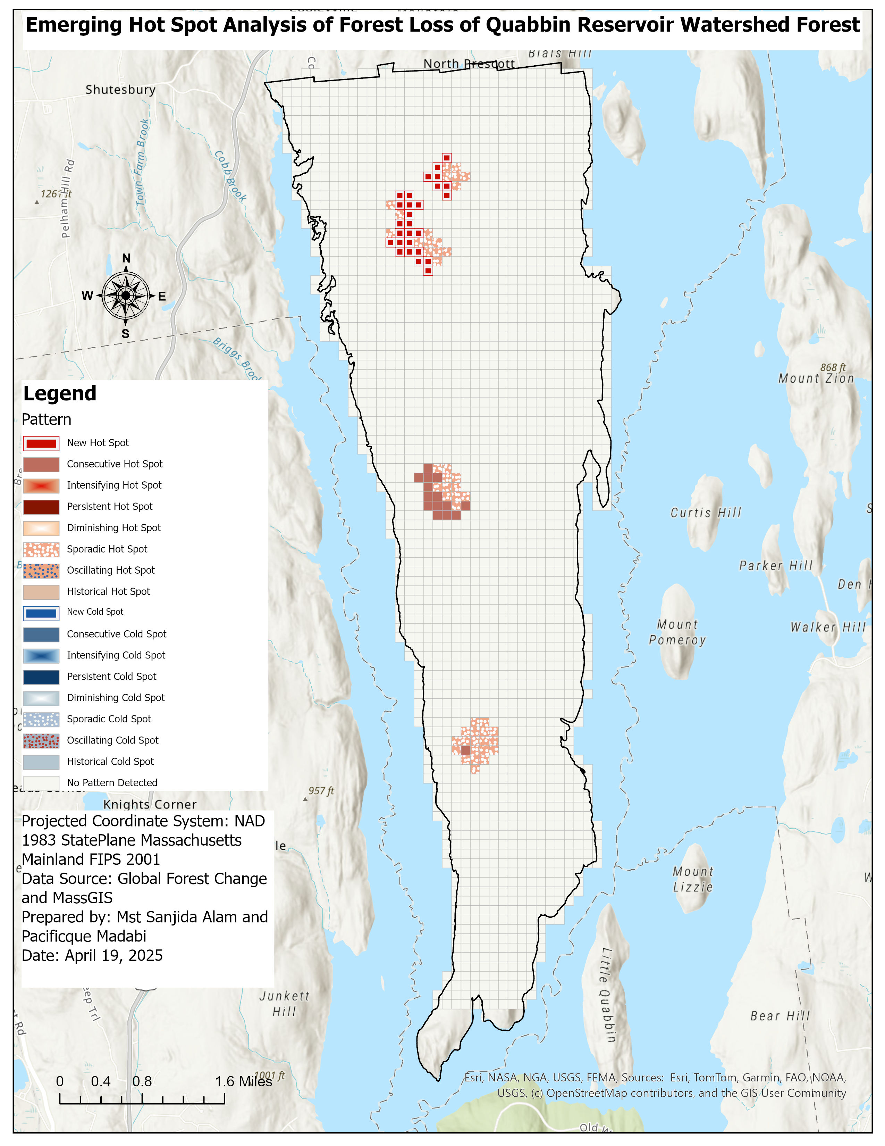
Emerging Hot Spot Analysis – Forest Loss (2000–2023)
New Hot Spots (27) point to northern areas where forest loss has only recently become significant, signaling emerging deforestation threats.
Consecutive Hot Spots (15) in the central zone indicate areas of sustained and escalating forest loss in recent years.
Sporadic Hot Spots (47) highlight locations of intermittent forest disturbance.
The analysis reveals emerging and clustered hot spots of forest loss, particularly in the northern and few in the central and southern sections of the watershed.
No cold spots detected. This emphasizes a unidirectional trend of forest degradation rather than a dynamic of loss and recovery.
Notes:
89 of 2269

Slide 12
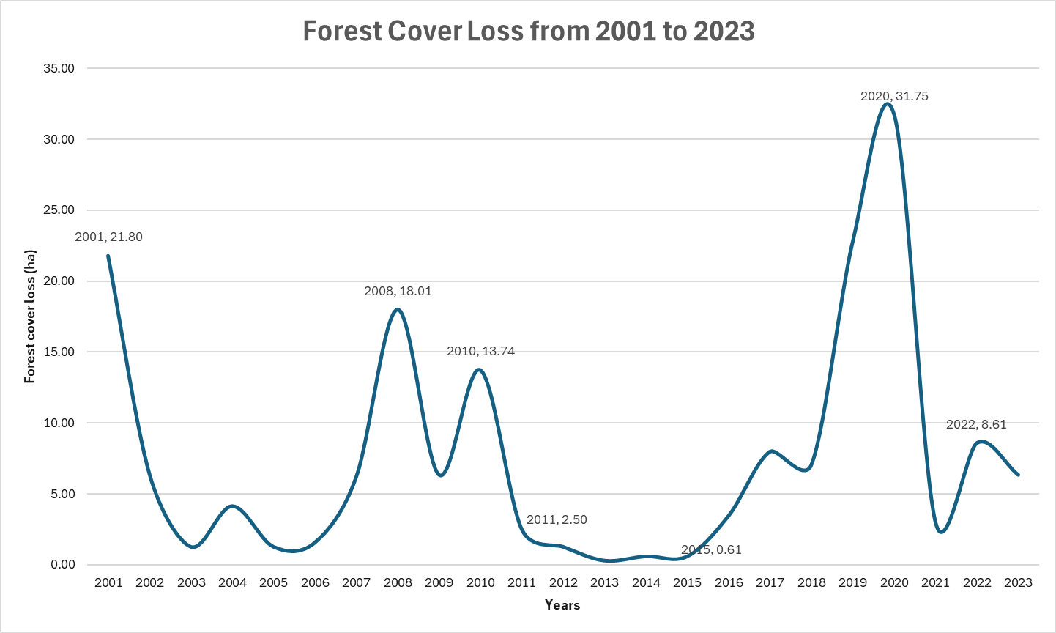

Slide 13
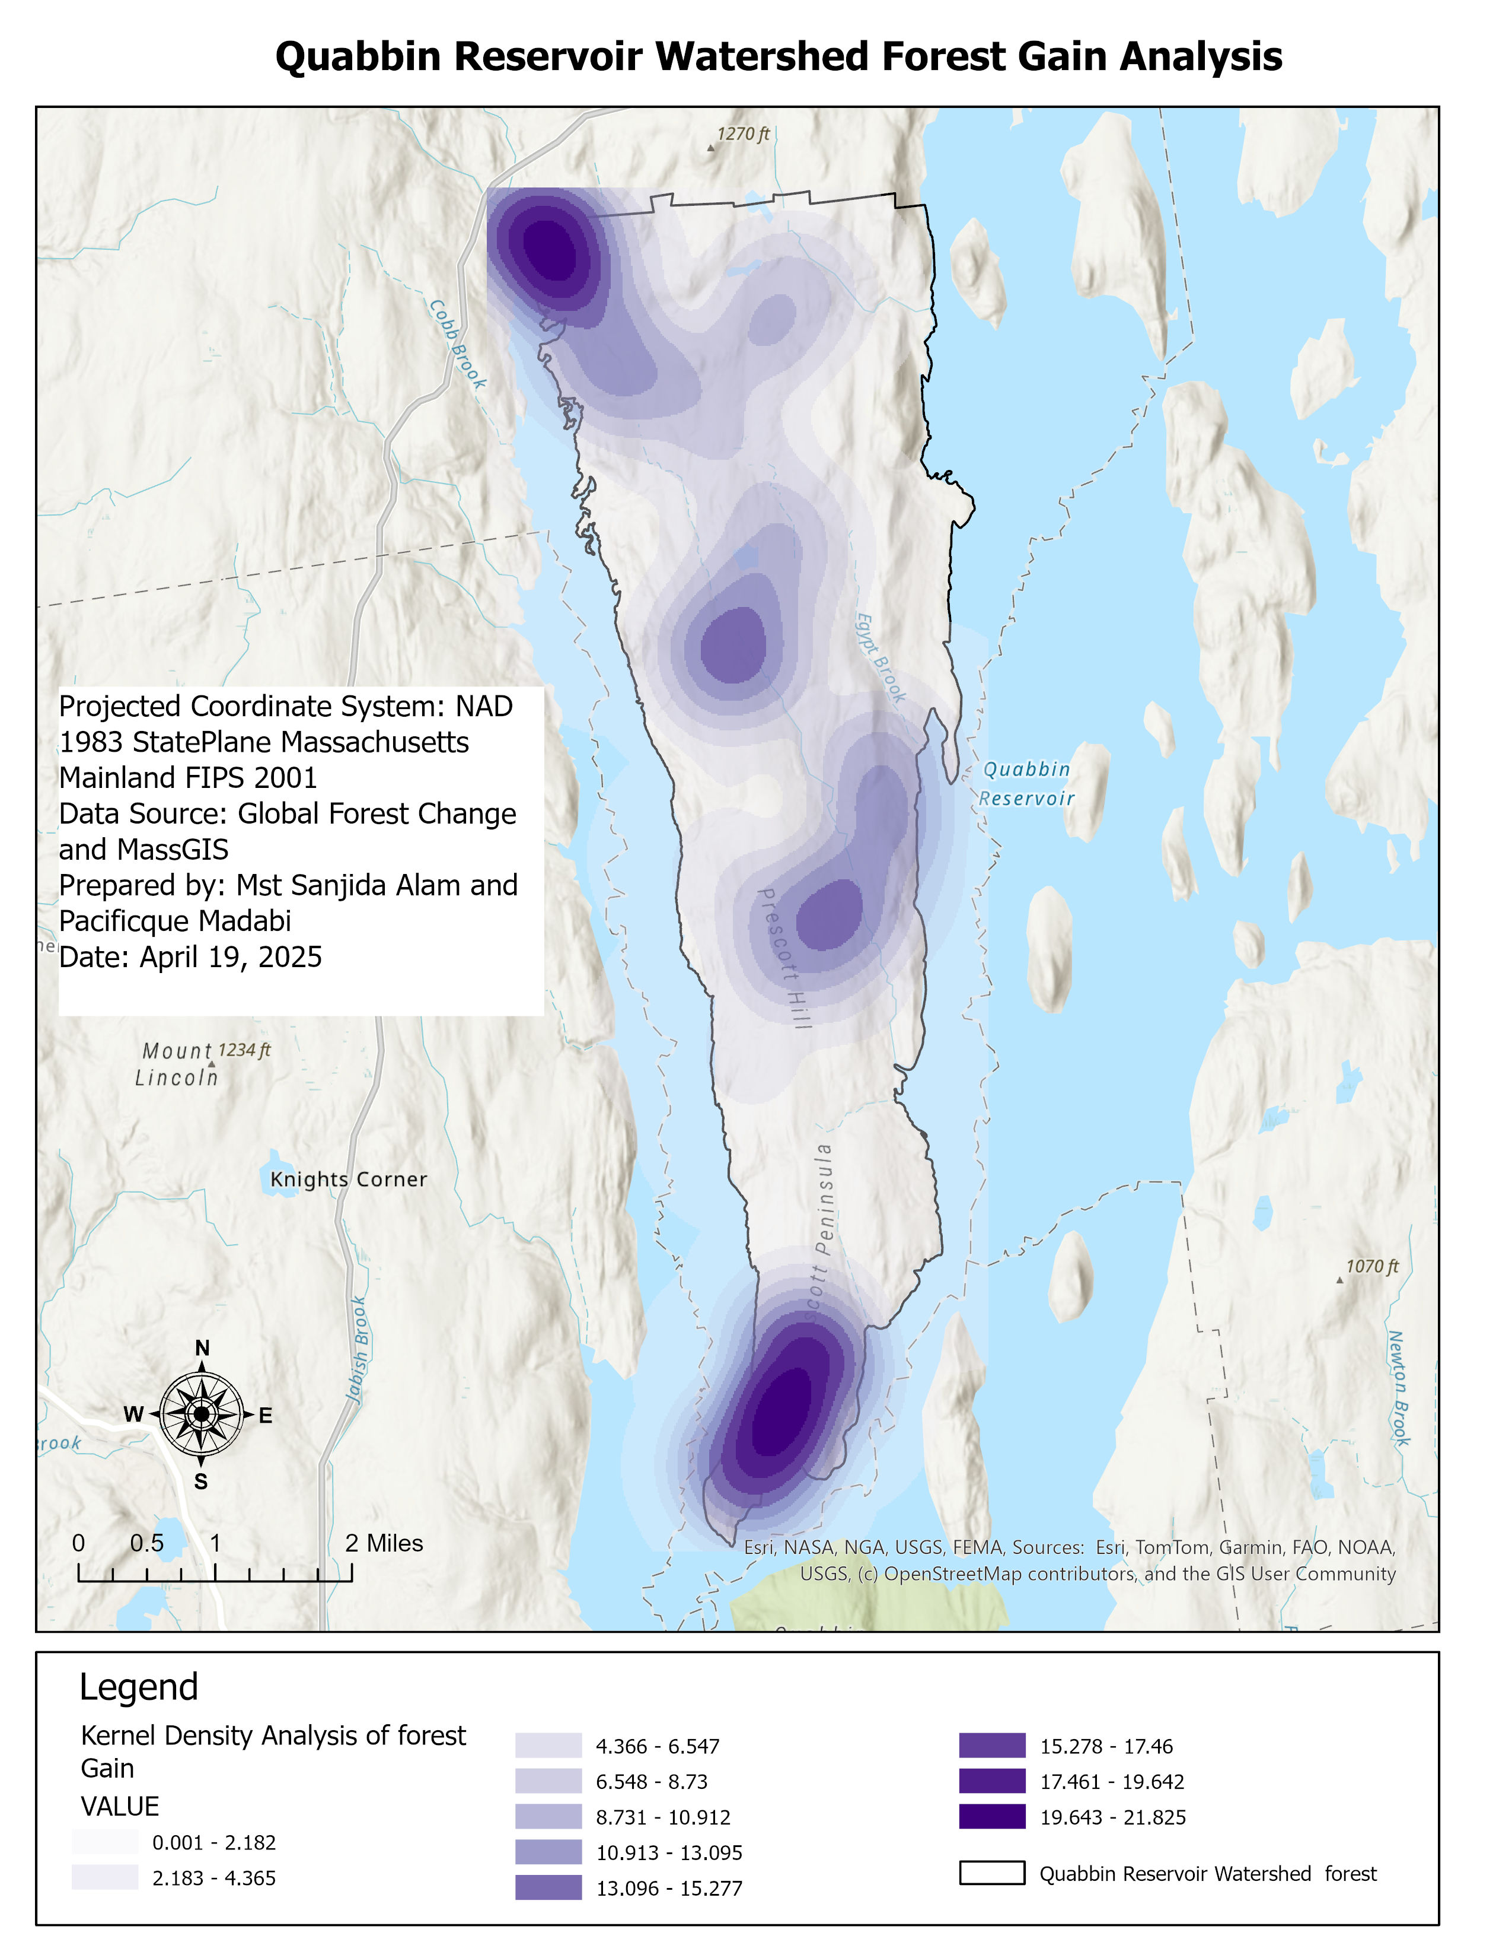
Forest Gain Analysis
Northern Zone (Cobb Brook Area): This zone exhibits moderate to high forest gain.
Central Zone (Prescott Hill Area): Characterized by low forest gain.
Southern Zone (Prescott Peninsula): The highest forest gain density is observed, and this area shows a well-defined cluster of intense forest recovery.

Slide 14
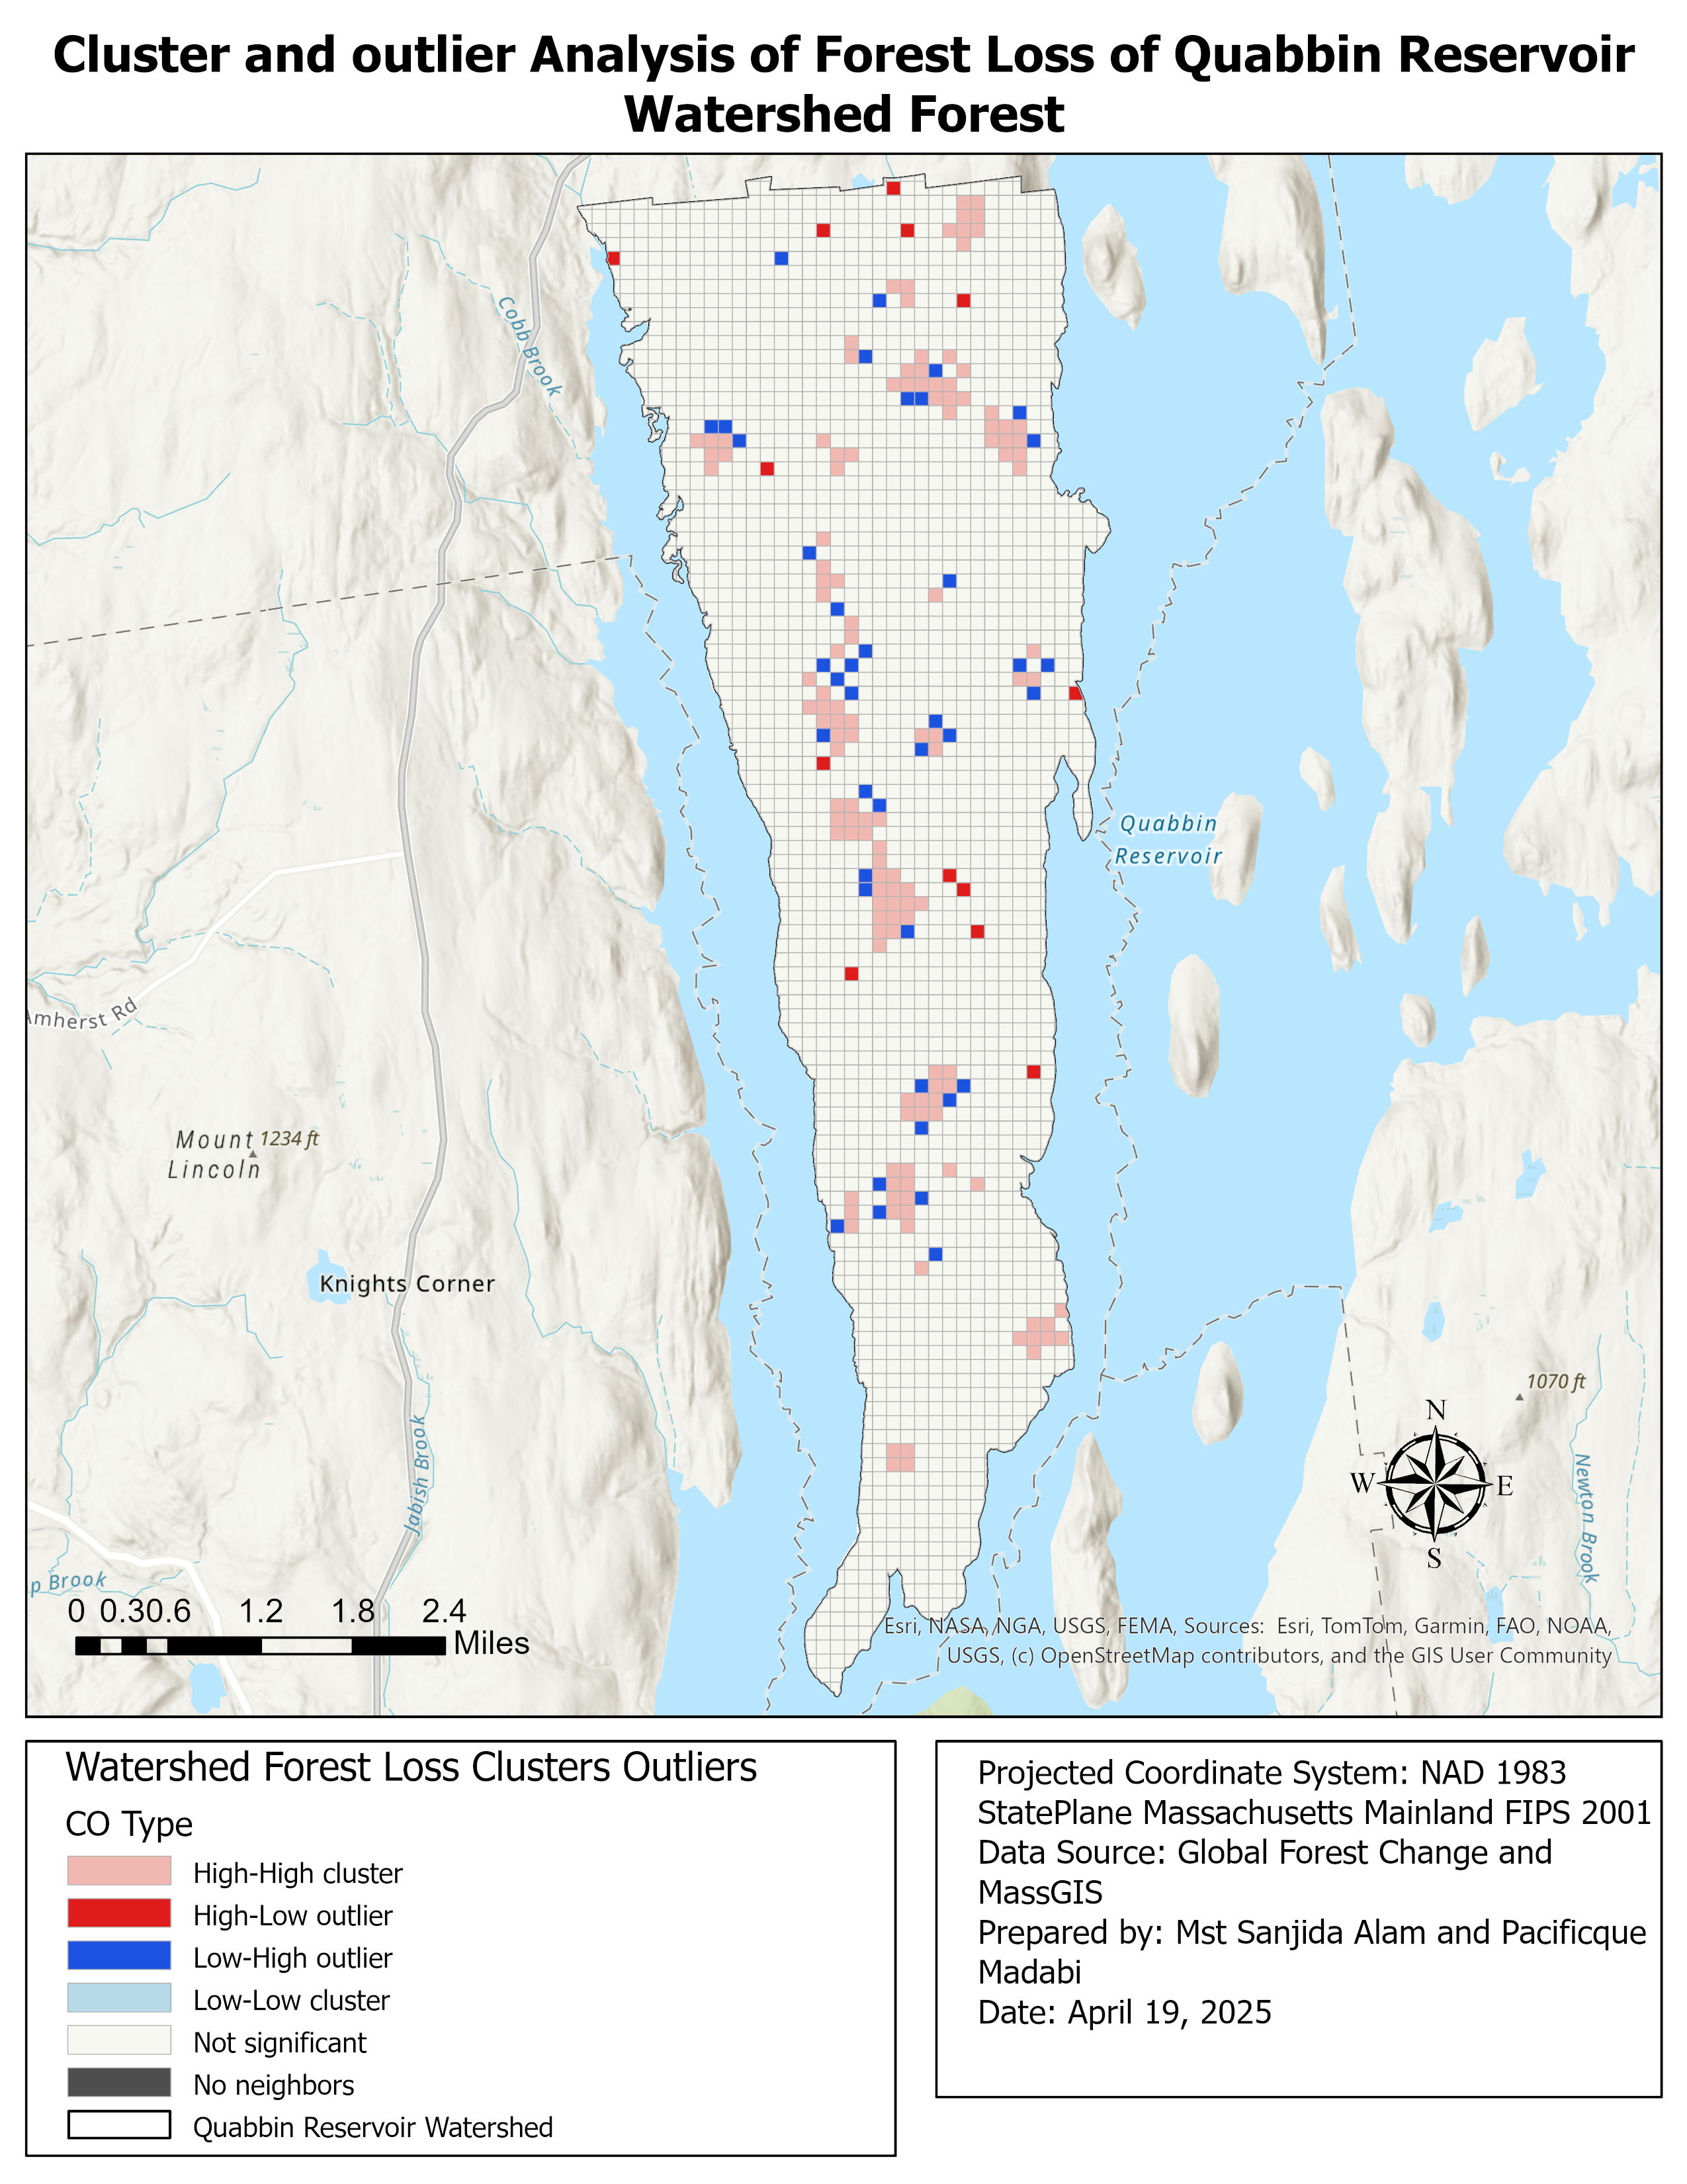
Cluster and Outlier Analysis of Forest Loss
High-High clusters in northeastern, central, and southern zones indicate key deforestation hotspots.
High-Low and Low-High outliers show isolated loss and resilient patches.
No Low-Low clusters detected.
Forest loss is uneven and concentrated in central and southern areas.

Slide 15
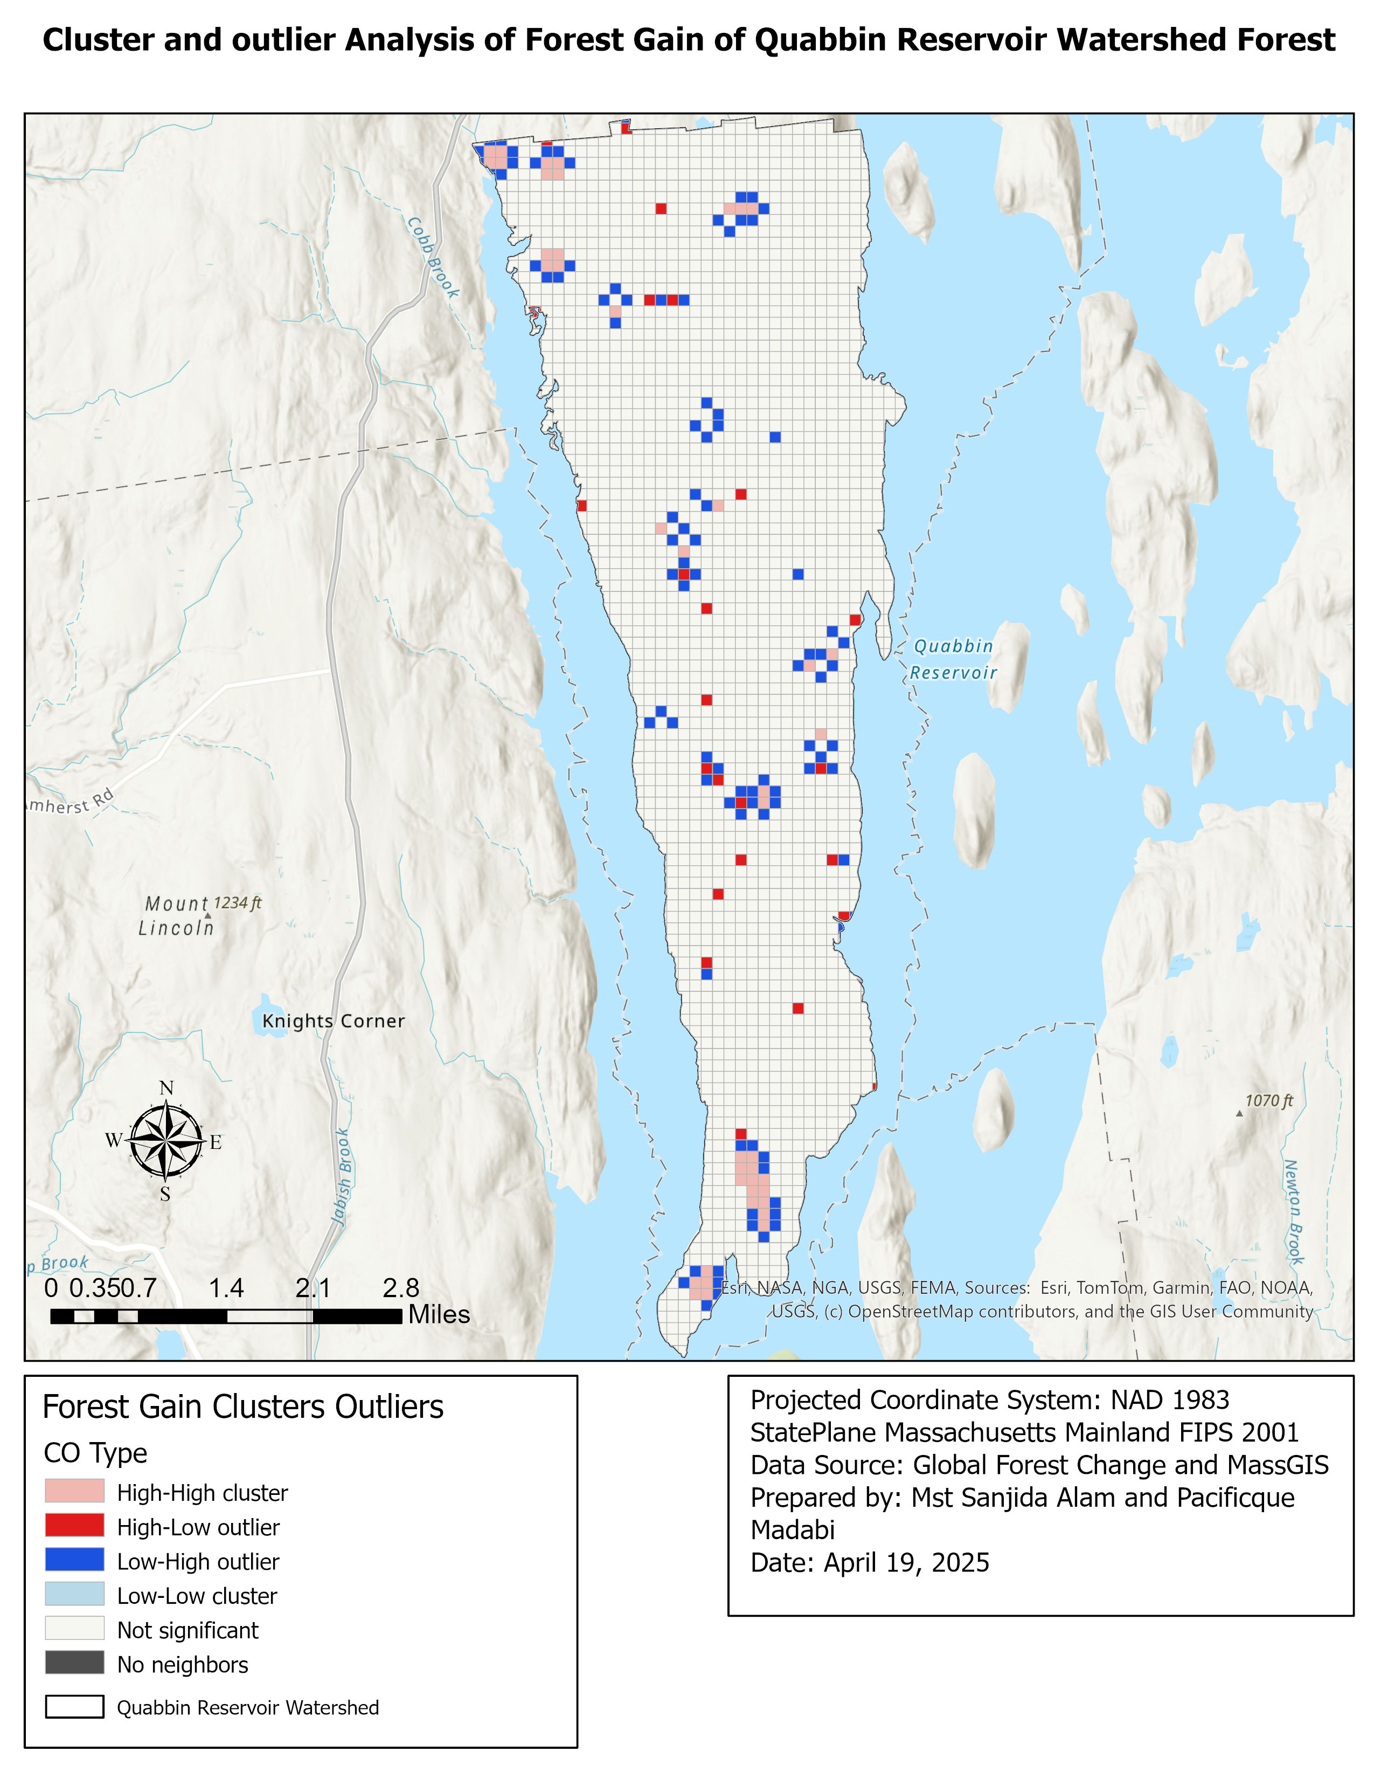
Cluster and Outlier Analysis of Forest Gain
High-High Clusters (Pink):Found primarily in the southern and some northern areas, these zones represent concentrated forest regeneration.
High-Low and Low-High Outliers (Red and Blue):Scattered throughout the watershed, these suggest inconsistent gain patterns or poor recovery in areas surrounded by high-gain cells.
✅ The map reveals a spatially uneven pattern of forest gain, with strong regeneration zones in the south, and low to medium gain clustering in the north and central.

Slide 16
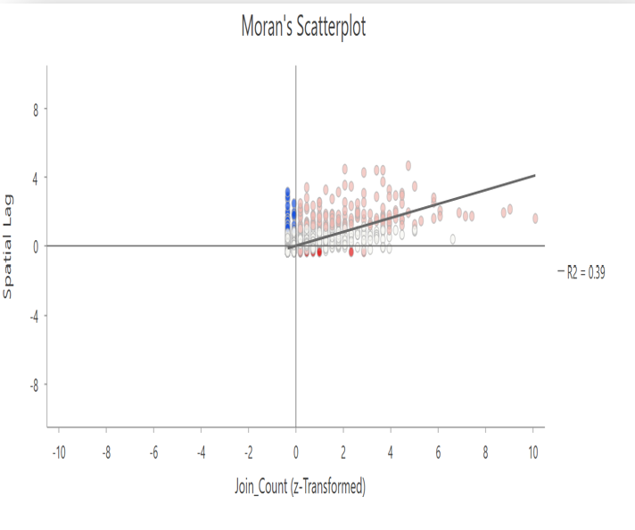
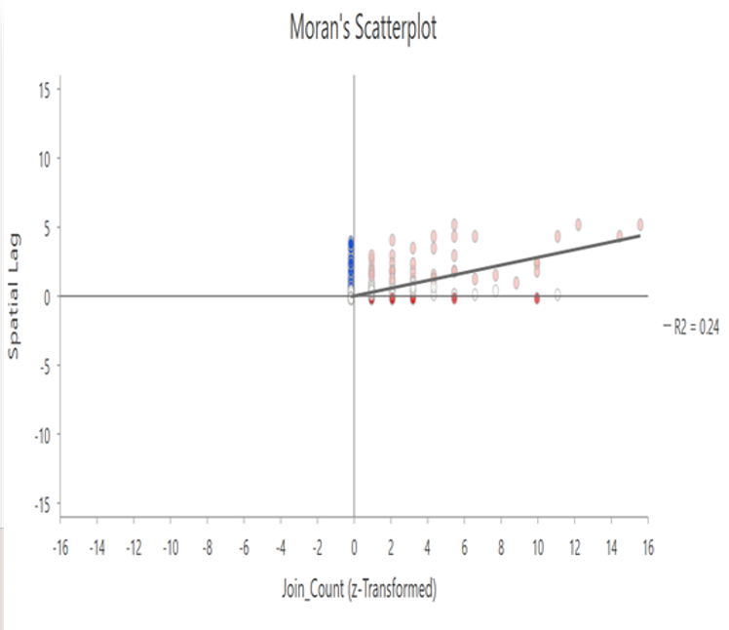
Positive Slope (R² = 0.39): Indicates moderate spatial autocorrelation.
High-High (Upper Right): Hot spots – high loss near high loss.
Low-Low (Lower Left): Cold spots – low loss near low loss.
High-Low & Low-High: Spatial outliers – values differ from neighbors.
✅ Confirms forest loss is moderately clustered, not random.
Positive Slope (R² = 0.24): Weak to moderate spatial autocorrelation.
High-High (Upper Right): Forest recovery clusters.
Low-Low (Lower Left): Low-regeneration zones.
High-Low & Low-High: Spatial outliers – gain differs from neighbors.
✅ Confirms forest gain is clustered, but less strongly than forest loss.

Slide 17
Change Summary
🔥 Forest Loss:
Hot spots mainly in southern, northern and central regions (New, Consecutive, Sporadic).
Peak loss years: 2001 & 2020.
Moderate spatial clustering (Moran’s I R² = 0.39), with High-High clusters in southern, central, and northern areas.
🌱 Forest Gain:
Highest gain in the southern zone (Prescott Peninsula); uneven patterns elsewhere.
Cluster analysis shows High-High in south, scattered outliers in central/north.
Weak to moderate clustering (Moran’s I R² = 0.24).

Slide 18
Limitation
Data Resolution: The Global Forest Change dataset has a 30-meter resolution, which may miss small-scale disturbances or regrowth.
Absence of Ground Validation: The study relies solely on remote sensing data; no field verification was conducted to confirm forest loss/gain patterns.

Slide 19
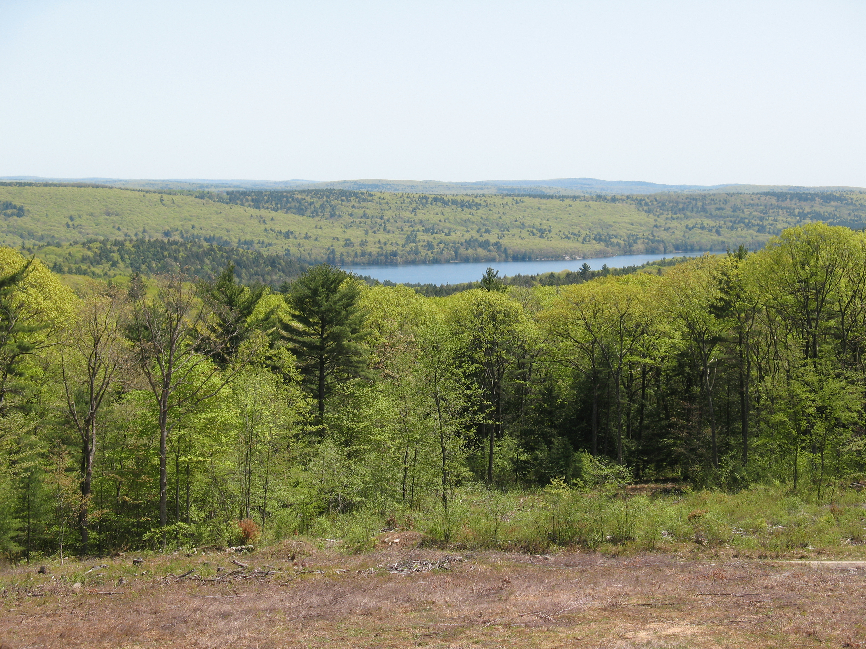
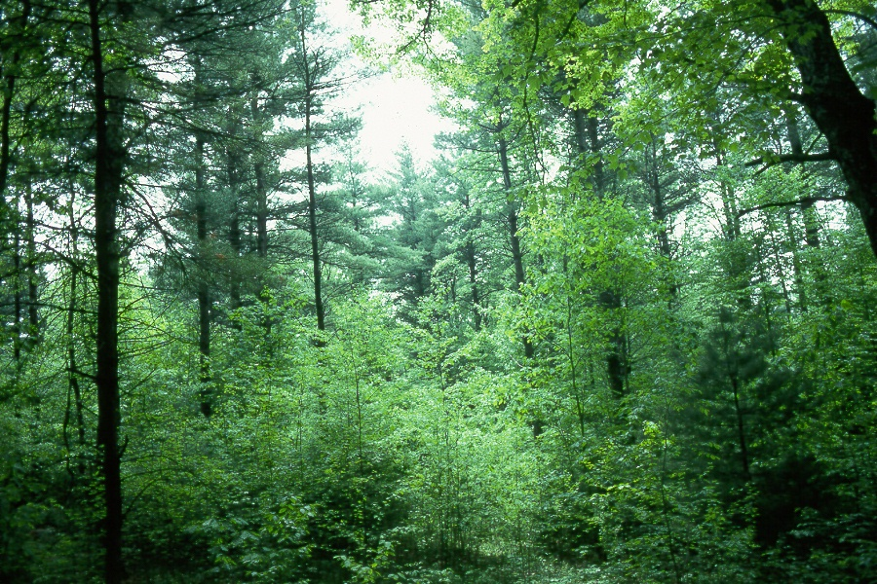
Conclusion
This study reveals that forest loss in the Quabbin Reservoir Watershed (2000–2023) is clustered in specific zones, particularly in the northeast, south and central regions.
In contrast, forest gain is more localized, with the highest recovery observed in the southern areas, but it is not sufficient to offset overall forest loss.
Spatial and temporal analyses using Hot Spot, Trend, and Moran’s I tools confirm the non-random nature of forest change.

Slide 20




Future Work
Incorporate data from high-resolution satellite data (e.g., Sentinel-2, PlanetScope) to improve detection of small-scale forest changes.
Extend the period of analysis to include post-2023 data for real-time forest monitoring and trend validation
Conduct field validation
Apply machine learning techniques for automated change detection and pattern recognition across large datasets.

Slide 21
References
Cuba, N., Sauls, L. A., Bebbington, A. J., Bebbington, D. H., Chicchon, A., Marimón, P. D., Diaz, O., Hecht, S., Kandel, S., & Osborne, T. (2022). Emerging hot spot analysis to indicate forest conservation priorities and efficacy on regional to continental scales: A study of forest change in Selva Maya 2000–2020. Environmental Research Communications, 4(7), 071004. https://doi.org/10.1088/2515-7620/ac82de
Hansen, M. C., Potapov, P. V., Moore, R., Hancher, M., Turubanova, S. A., Tyukavina, A., Thau, D., Stehman, S. V., Goetz, S. J., Loveland, T. R., Kommareddy, A., Egorov, A., Chini, L., Justice, C. O., & Townshend, J. R. G. (2013). High-resolution global maps of 21st-century forest cover change. Science, 342(6160), 850–853. https://doi.org/10.1126/science.1244693
Hansen, M. C., University of Maryland, Google, USGS, & NASA. (2023).
Global Forest Change 2000–2023 (v1.11) [Dataset]. Global Land Analysis and Discovery (GLAD) Lab, University of Maryland. https://glad.earthengine.app/view/global-forest-change
MassGIS. (2023). Protected and Recreational OpenSpace. https://www.mass.gov/info-details/massgis-data-protected-and-recreational-openspace
Massachusetts Department of Conservation and Recreation (DCR). (2023). Quabbin Reservoir Watershed System. Retrieved from https://www.mass.gov/locations/quabbin-reservoir

Slide 22
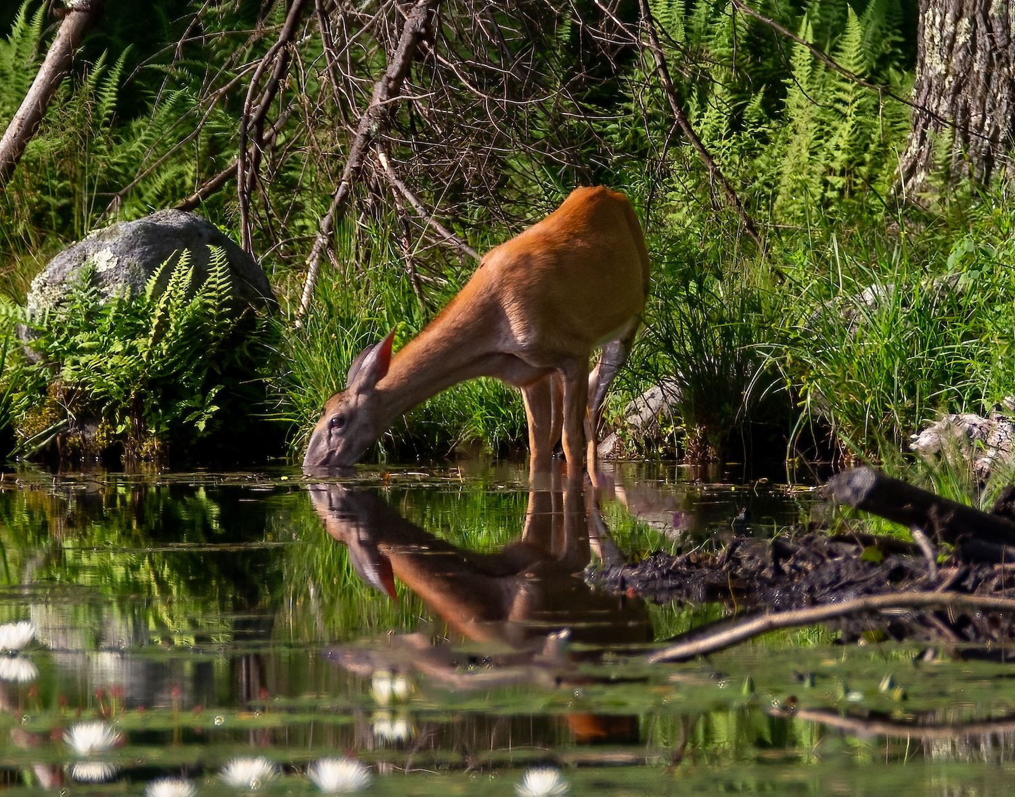
Thanks

