Slide 1

SPATIO-TEMPORAL ANALYSIS OF SCHOOL DISTRICT DROPOUT RATE IN MA, USA
Mst Sanjida Alam

Slide 2

Introduction
A school district is an administrative unit responsible for managing primary and secondary schools, consisting of one or more public schools operated under the supervision of a school committee and a superintendent (MassGIS, 2019).
A dropout is defined as a student in grade nine through twelve who leaves school prior to graduation for reasons other than transfer to another school and dropout rate is the number of students who drop out over a one-year period (DESE, 2023)
This study aims to present the dropout rates across Massachusetts school districts and analyze their spatial and temporal patterns using statistical methods.

Slide 3
Objectives
To represent the spatial patterns and temporal trends of school district dropout rates.
To present the dropout patterns across different grades, genders, and ethnicities over time.

Slide 4
Methodology
Step 1: Data Collection
Collected dropout data (2009–10, 2015–16, 2021–22) from Massachusetts DESE:
  Appendix A: School-level dropout rates
  Appendix B: Dropout rates by grade, gender, ethnicity
Downloaded school district shapefile from MassGIS
Step 3: Spatial Data Integration in ArcGIS Pro
Converted Appendix A Excel file to CSV
Imported shapefile and CSV into ArcGIS Pro
Performed spatial join using 'Add Join' on 'District Name’
Generated output layer with dropout data
Step 2: Data Preprocessing
Step 4: Spatial Statistical Analysis (ArcGIS Pro)
Used Mean Center tool to find the central point of dropout distribution (each year)
Applied Standard Deviational Ellipse to assess spatial spread and direction
Step 5: Statistical Analysis (Excel and R)
Combined all three years of Appendix B in Excel
Imported the combined dataset into R and Performed Descriptive Statistics and ANOVA
Visualizations using ggplot2 (R) and Excel (bar charts by grade, gender, and ethnicity)

Slide 5
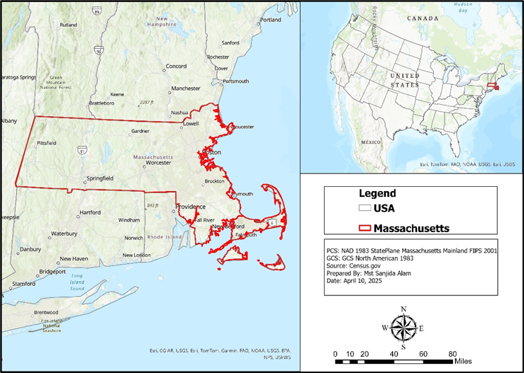
The area of the study includes all school districts within the state of Massachusetts. The number of School Districts in this state are 399, Number of Schools 1,827, Enrollment 914,959, and Grades Served PK-12 (DESE, 2024).
Study Area

Slide 6
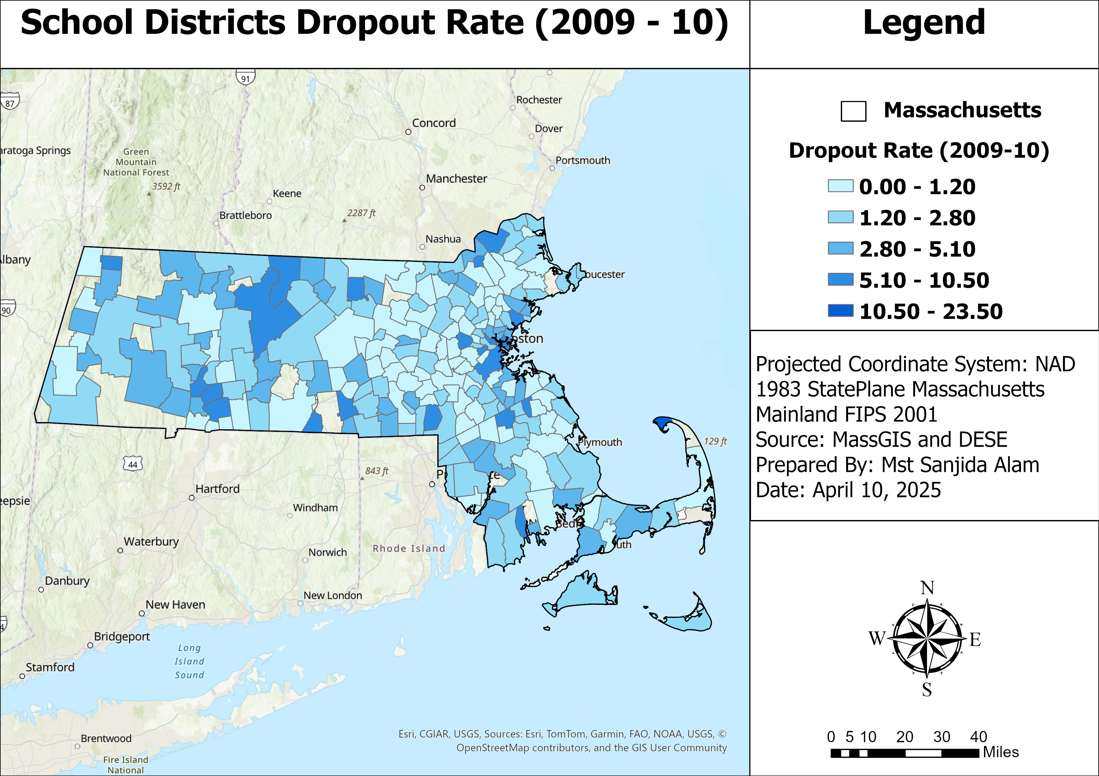
Result and Discussion
This map shows dropout rates of academic year 2009–2010 across Massachusetts school districts.
High dropout areas: Springfield, Holyoke, Lawrence (Western and center east zones).
Low dropout areas: Lexington, Newton, Brookline (Eastern zone).

Slide 7
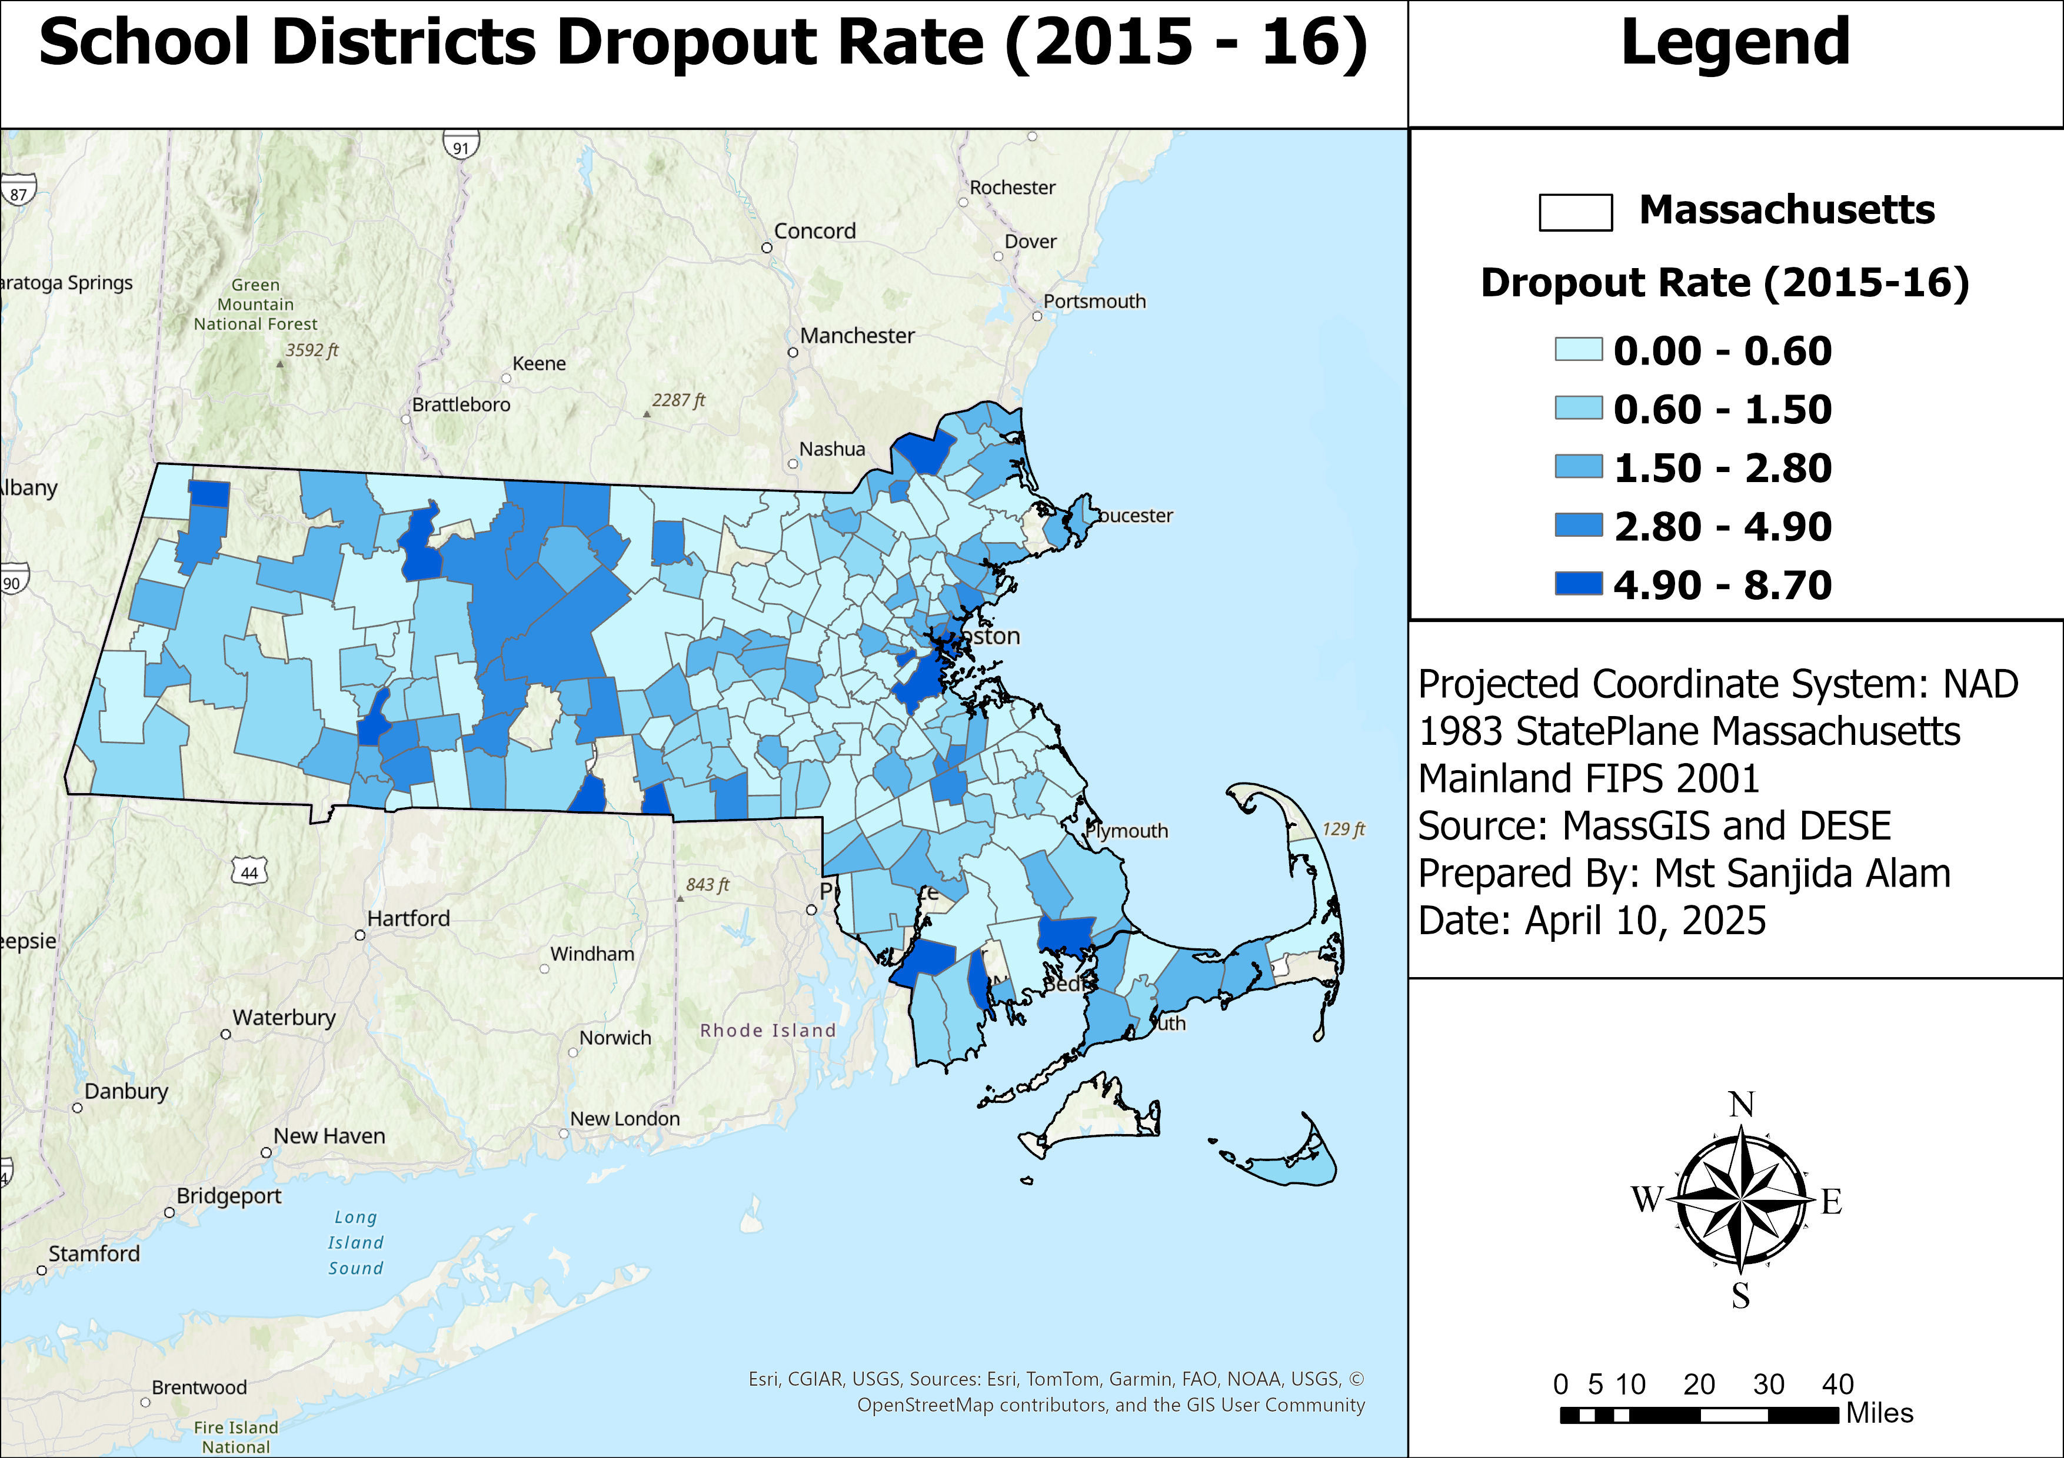
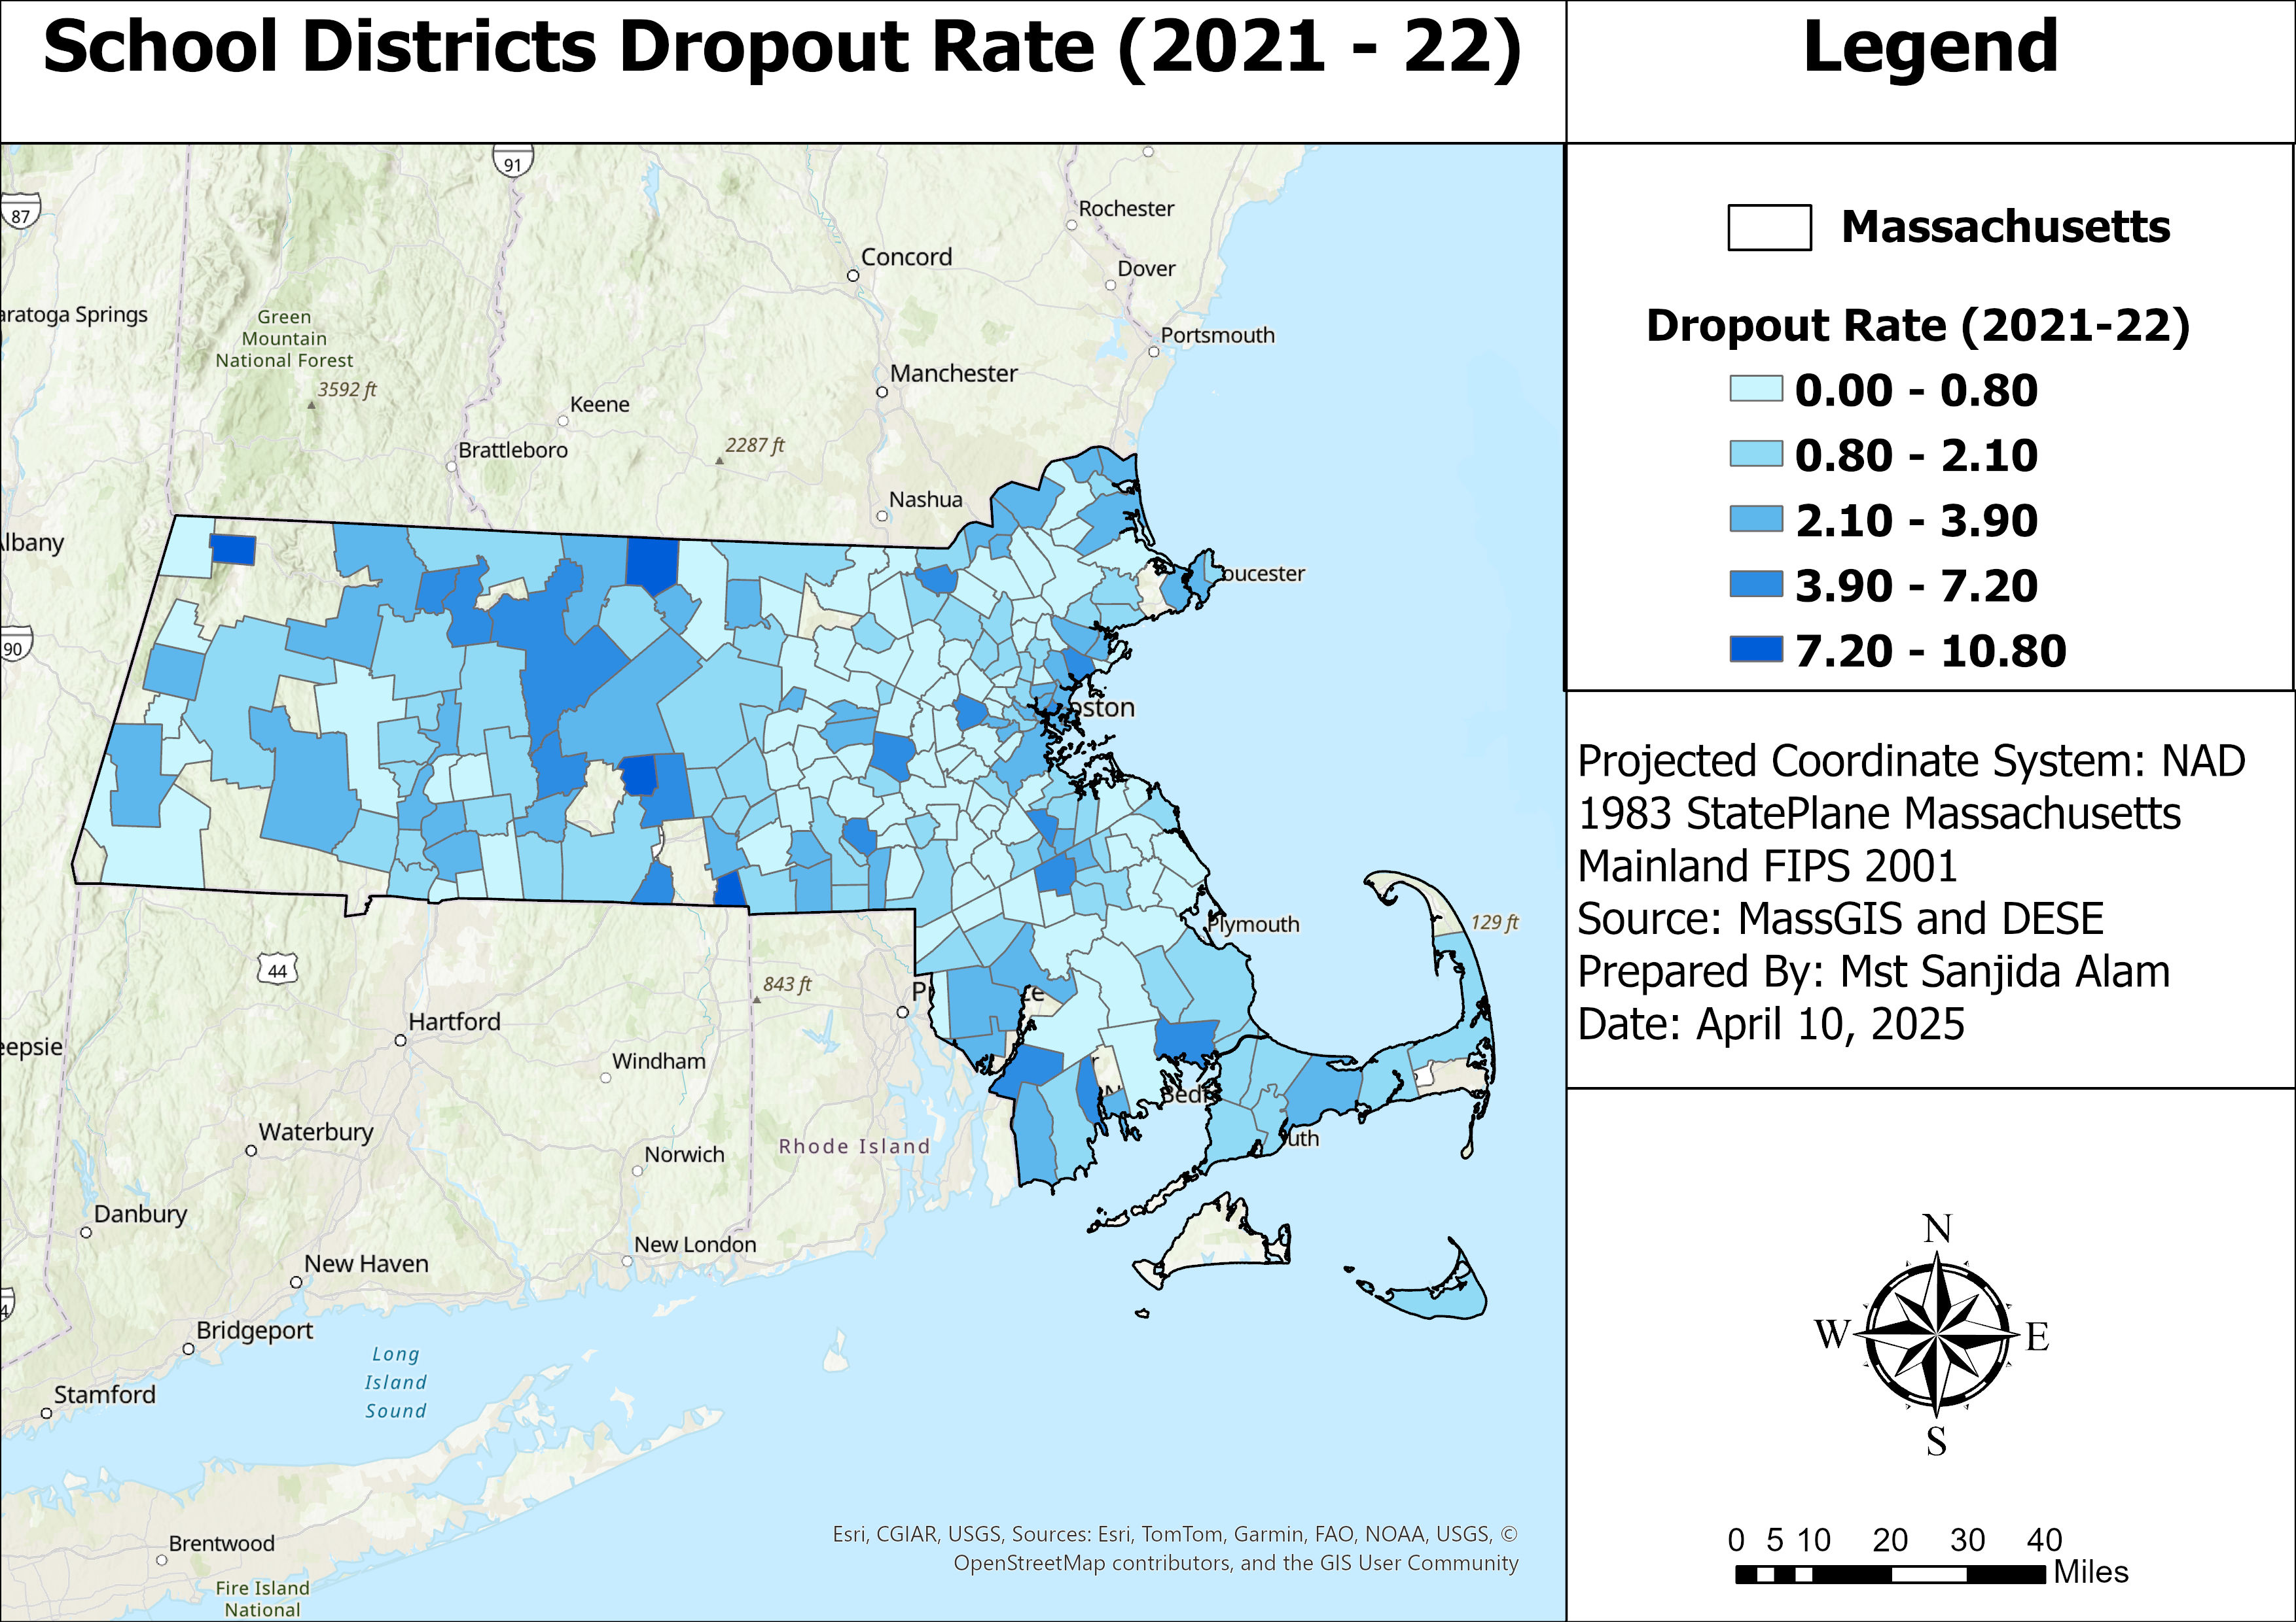
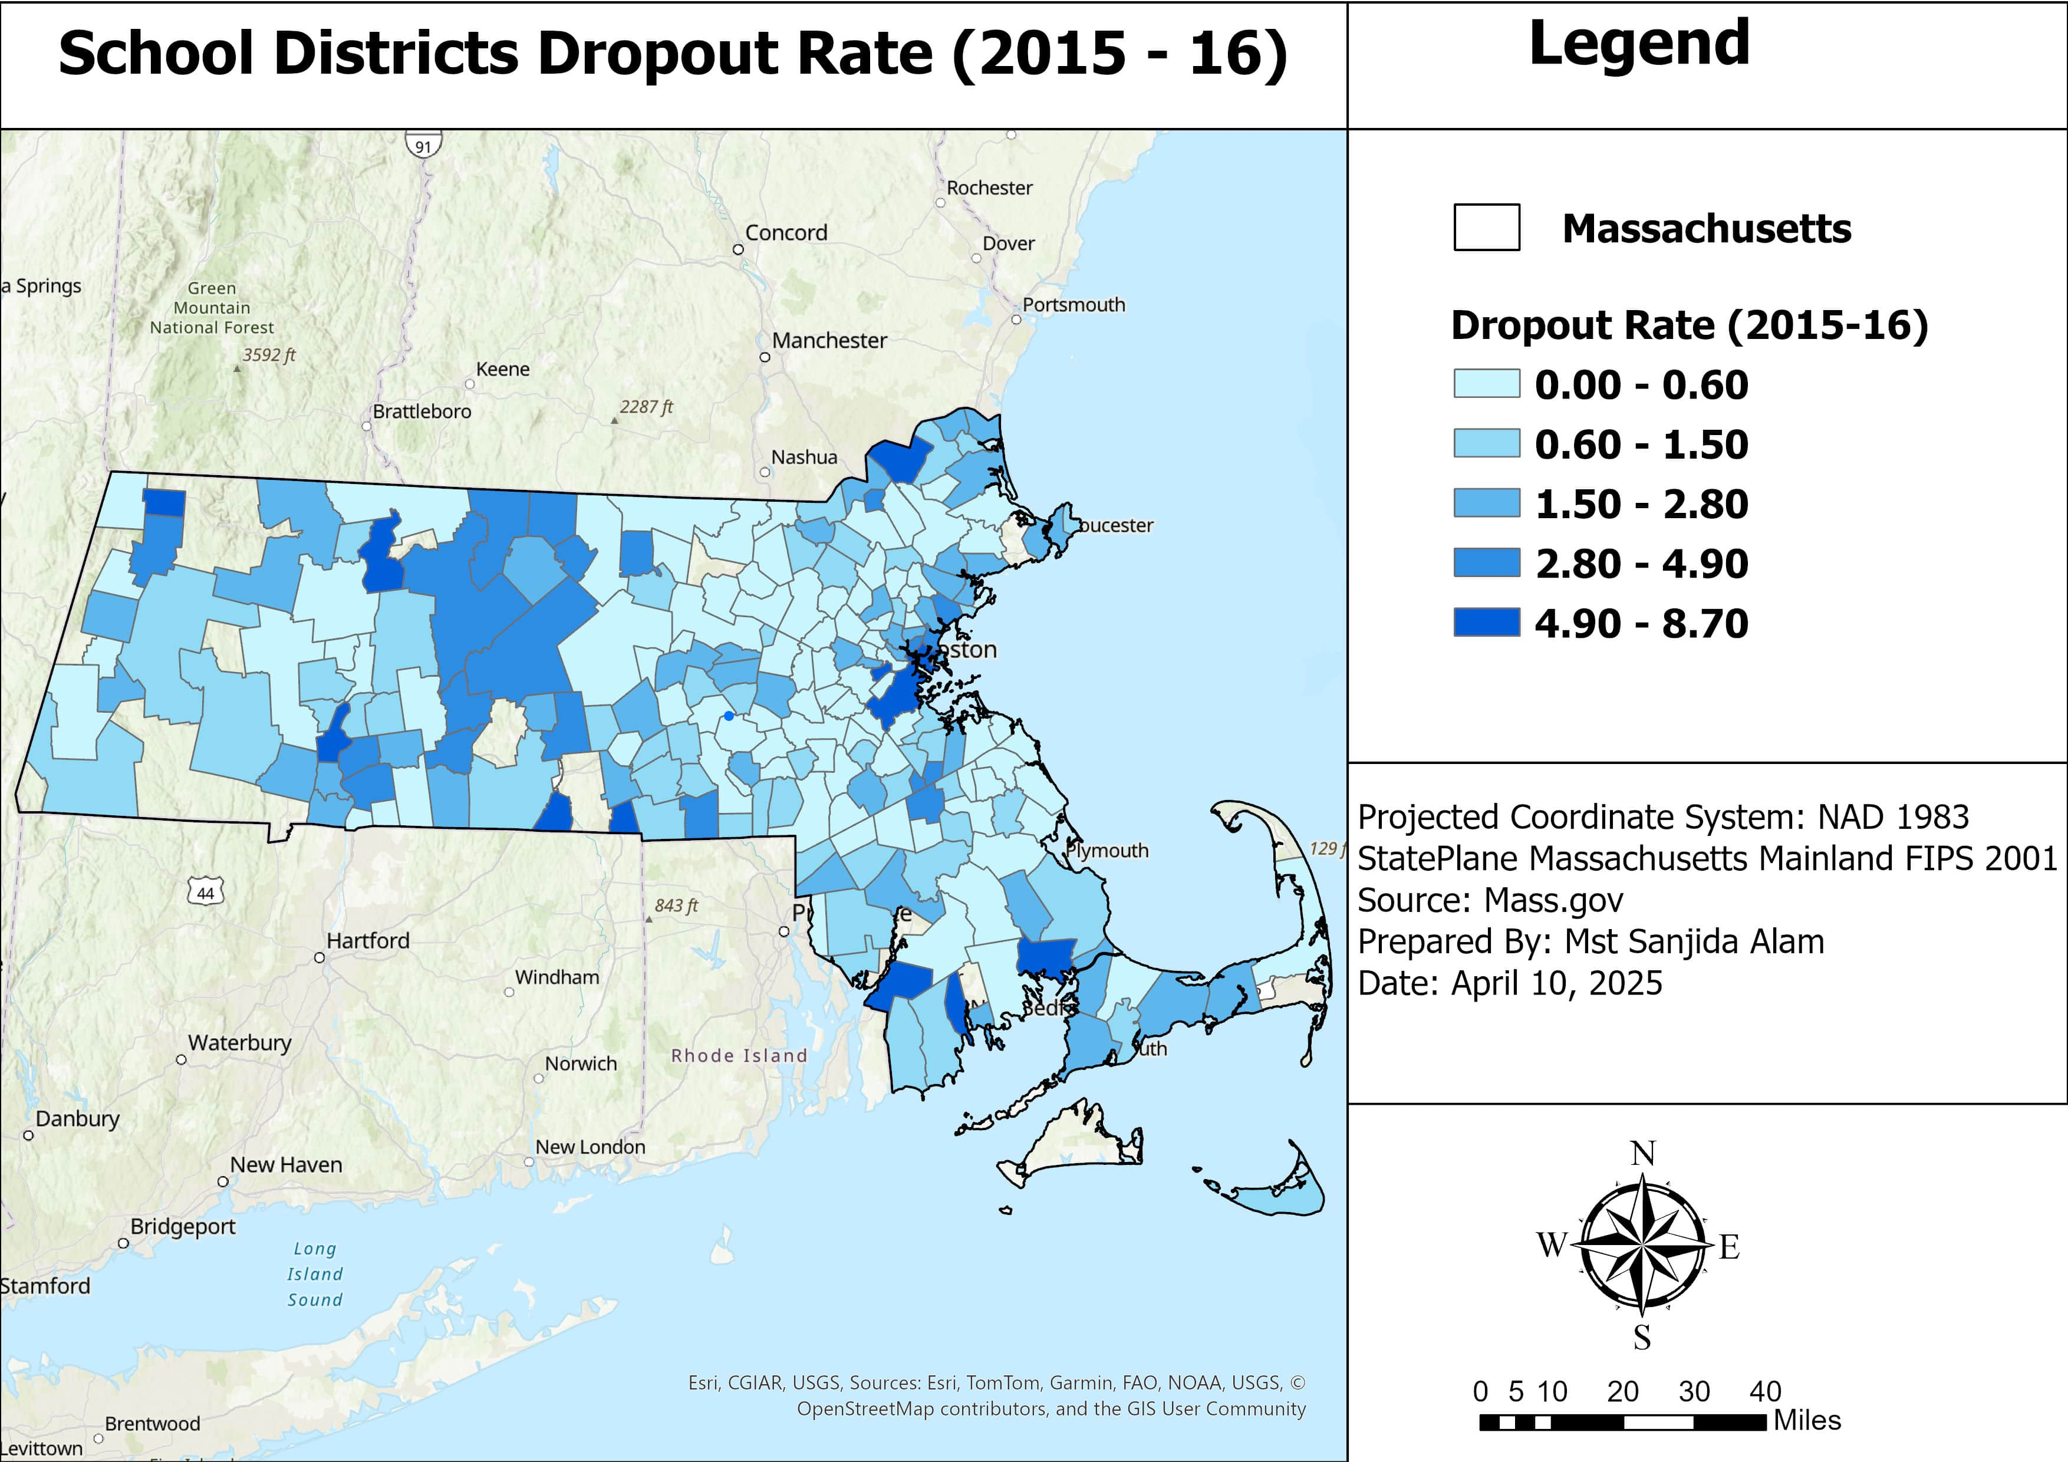
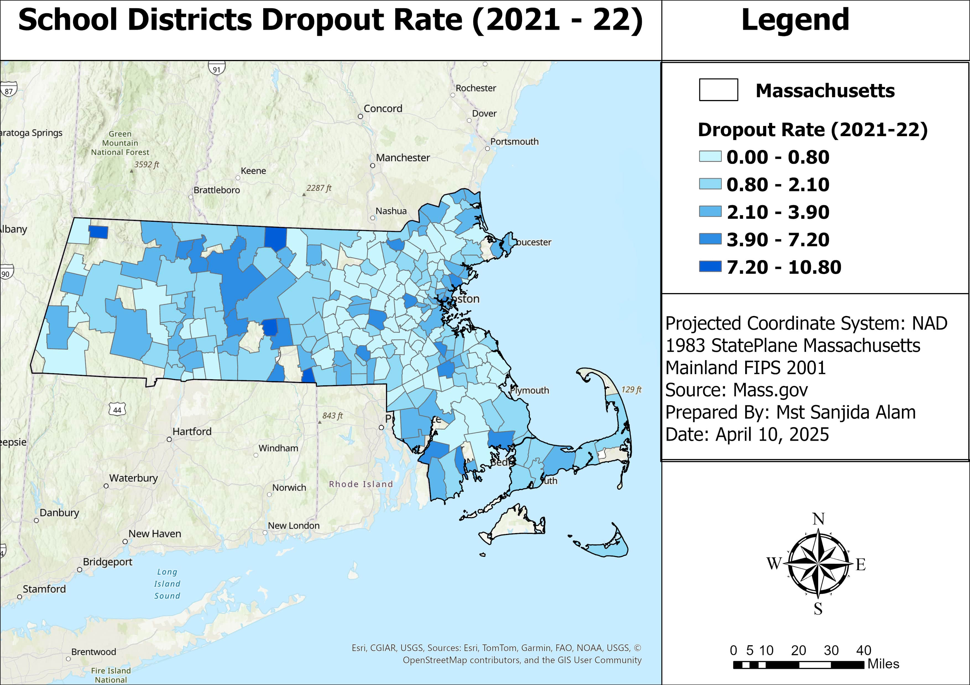
2015–16 Dropout Trends
High dropout common in southeastern districts and west-central areas.
Lower dropout seen in central and northeastern regions.
2021–22 Dropout Trends
High dropout in southeastern (New Bedford, Fall River), western (Holyoke), and south-central (Southbridge) regions.
Low dropout in northeastern (Lexington, Andover), and central (Shrewsbury, Newton) regions.

Slide 8
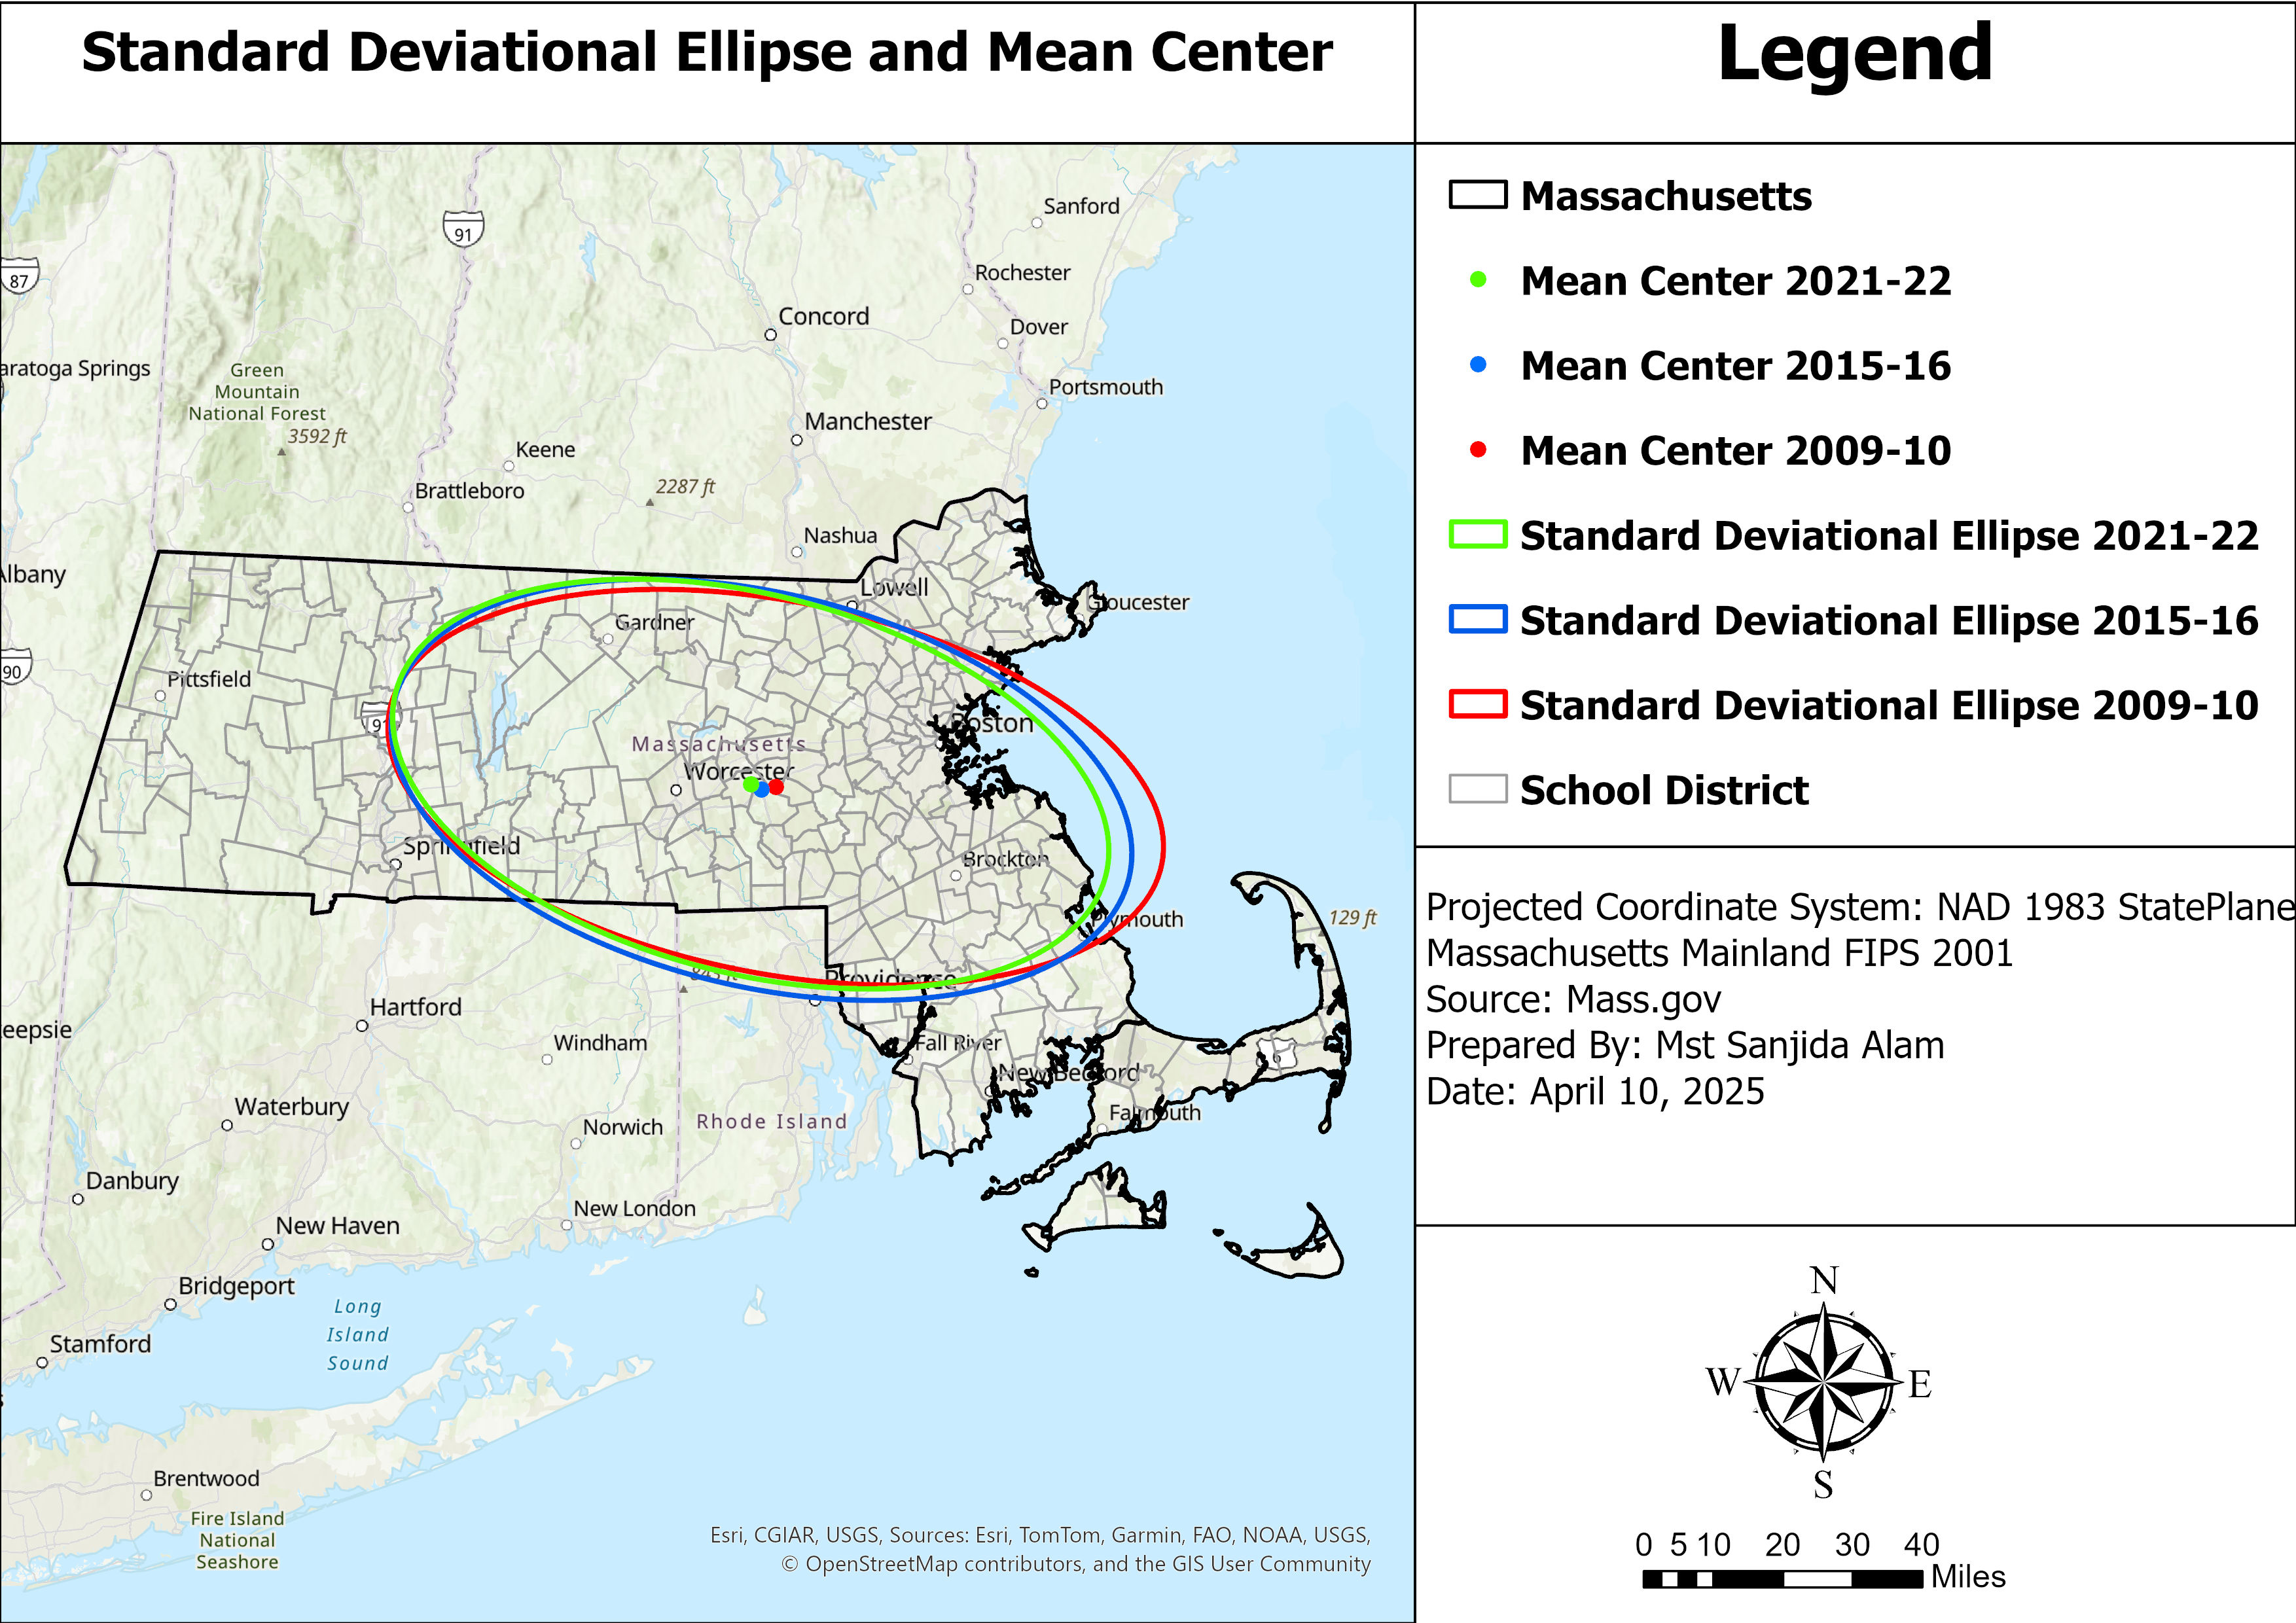
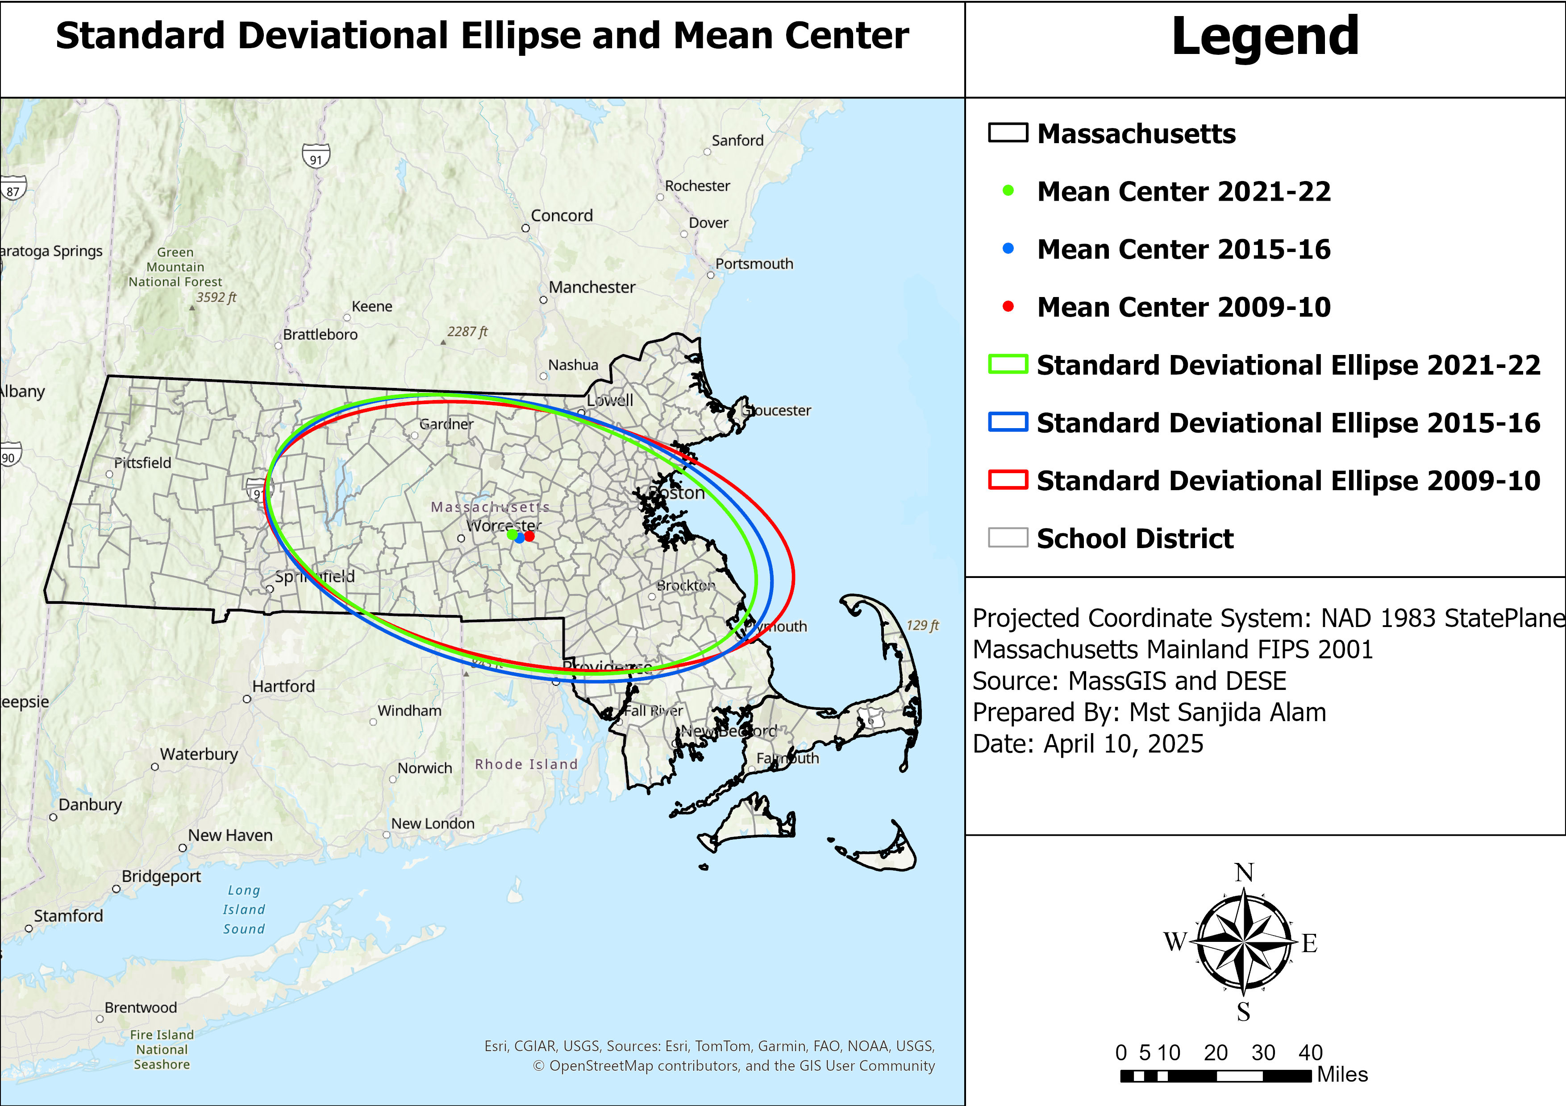
In 2009–10, the mean center was located near central- east, with a wide ellipse extending eastward, indicating a dispersed and widespread pattern of dropout rates.
In 2015–16, the mean center shifted slightly west, and the ellipse expanded westward and southward, reflecting a growing concentration of dropout rates in western and south-central regions.
By 2021–22, the mean center moved further west, and the ellipse stretched slightly westward but became narrower, suggesting that dropout rates became more concentrated in the western part of the state.

Slide 9

Analysis of Dropout rate as per grade, gender and ethnicity

Slide 10
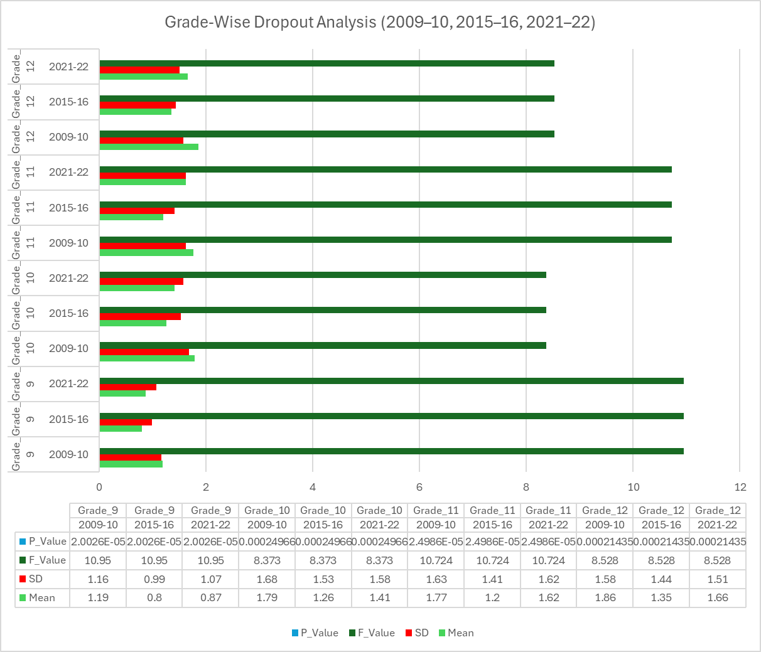
Grade-Wise Dropout Analysis (2009–10, 2015–16, 2021–22)
Grade 9 had a notably higher dropout rate in 2009–10 (Mean = 1.19%) dropping to 0.87% by 2021–22.
Grade 10 had the highest dropout mean in 2009–10 (1.79%), which gradually decreased in later years.
Grade 11 exhibited a fluctuating pattern, with a slight increase again in 2021–22 after a drop in 2015–16.
Grade 12 consistently showed higher dropout rates than lower grades, especially in 2009–10 (1.86%).
P-Values are consistently very low (e.g., 2E-05, 0.000214), confirming that the differences in dropout rates across years are statistically significant for all grade levels.
Overall, a significant reduction in dropout rates over time particularly Grade 9 and Grade 10. However, attention may still be needed in Grades 11 and 12, where dropout rates remain relatively high in recent years.

Slide 11
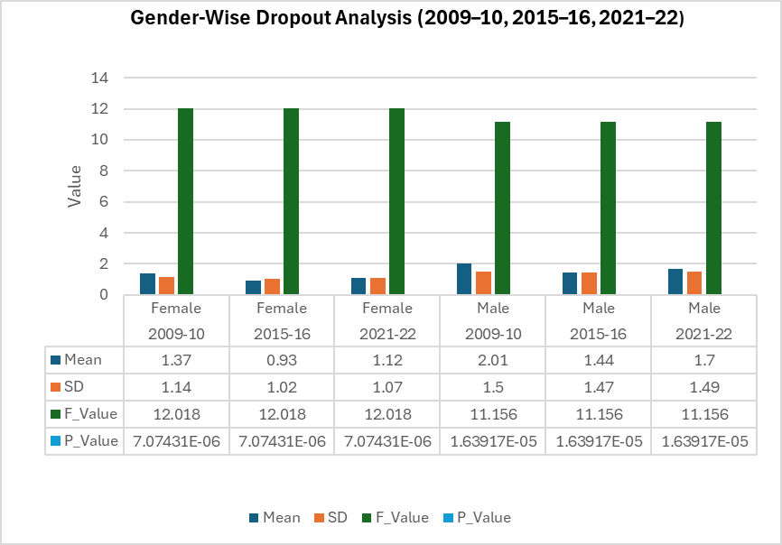
Gender-Wise Dropout Analysis (2009–10, 2015–16, 2021–22)
🔹 Female Students: Dropout rates declined significantly from 1.37% (2009–10) to 1.12% (2021–22). P-value = 7.07E-06 indicate a statistically significant difference across the years.
🔹Male Students: Dropout rates showed a modest decline, from 2.01% (2009–10) to 1.7% (2021–22). Despite the reduction, male dropout rates remained consistently higher than female rates in all years. P-value = 1.64E-05 confirm that the change in male dropout rates is also statistically significant.
📌 Overall, both genders show a significant reduction in dropout rates, with greater improvement observed among female students.

Slide 12
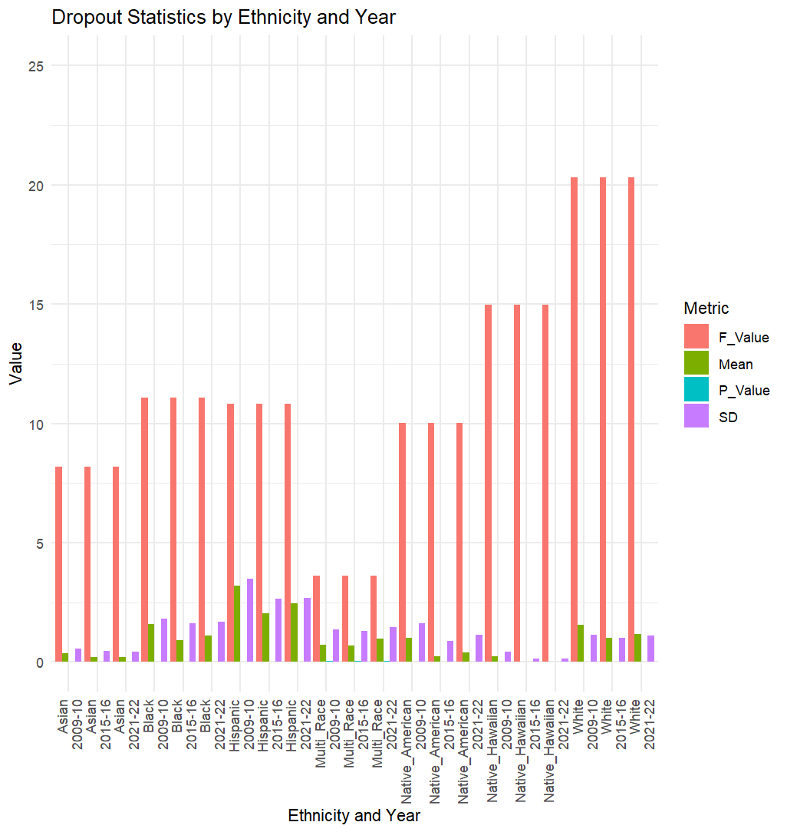
Ethnicity-Wise Dropout Rate Analysis
🔹 Highest Dropout Rates
Hispanic students had the highest dropout rates across all years, peaking at 3.19% in 2009–10, though reduced in subsequent years.
Black and White students also showed higher dropout means, though with improvement in 2015–16 and a slight rise in 2021–22.
🔹 Lowest Dropout Rates
Asian and Native Hawaiian students consistently had the lowest dropout rates, under 0.5%, with very little variation.

Slide 13
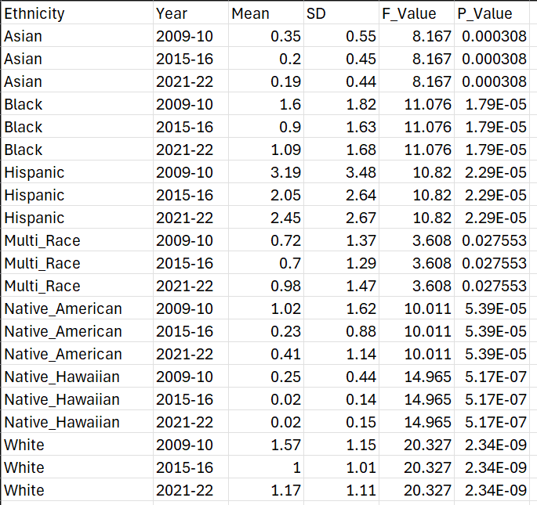
Ethnicity-Wise Dropout Rate Analysis
All groups show statistically significant changes across years (p < 0.05 in all cases).
While dropout rates improved across most ethnic groups, disparities remain. Targeted interventions are still needed for Hispanic, Black, and white populations to ensure equitable outcomes.

Slide 14

Limitation
The analysis is limited to three academic years and relies on secondary data, which may not capture all contextual factors influencing dropout rates.

Slide 15

Recommendation
Strengthen support programs in upper grades (11 and 12), male, Hispanic, white and Black students where dropout rates remain high.
Allocate appropriate resources for high dropout districts.

Slide 16

Conclusion
The study reveals that high dropout areas were concentrated in western and southeastern Massachusetts across the years. The mean center shifted west over time, and ellipses narrowed, suggesting dropout rates became more regionally concentrated over the period.
The study discloses a declining trend in dropout rates across grades, genders, and ethnicities. However, disparities remain among Grades 11–12, male, Hispanic, white and Black students, highlight the need for constant educational initiatives.

Slide 17
Reference
Massachusetts Department of Elementary and Secondary Education (DESE). (2023). School and District Dropout Reports by Student Group. Retrieved from https://www.doe.mass.edu
Massachusetts Department of Elementary and Secondary Education (DESE). (2024). Boston Public Schools profile. DESE Profiles. Retrieved (April 4, 2025) from https://profiles.doe.mass.edu/profiles/general.aspx?topNavId=1&orgcode=01590005&orgtypecode=6&leftNavId=102
MassGIS (Bureau of Geographic Information). (2019). Massachusetts School Districts Shapefile. Commonwealth of Massachusetts. Retrieved from https://www.mass.gov/orgs/massgis-bureau-of-geographic-information

Slide 18
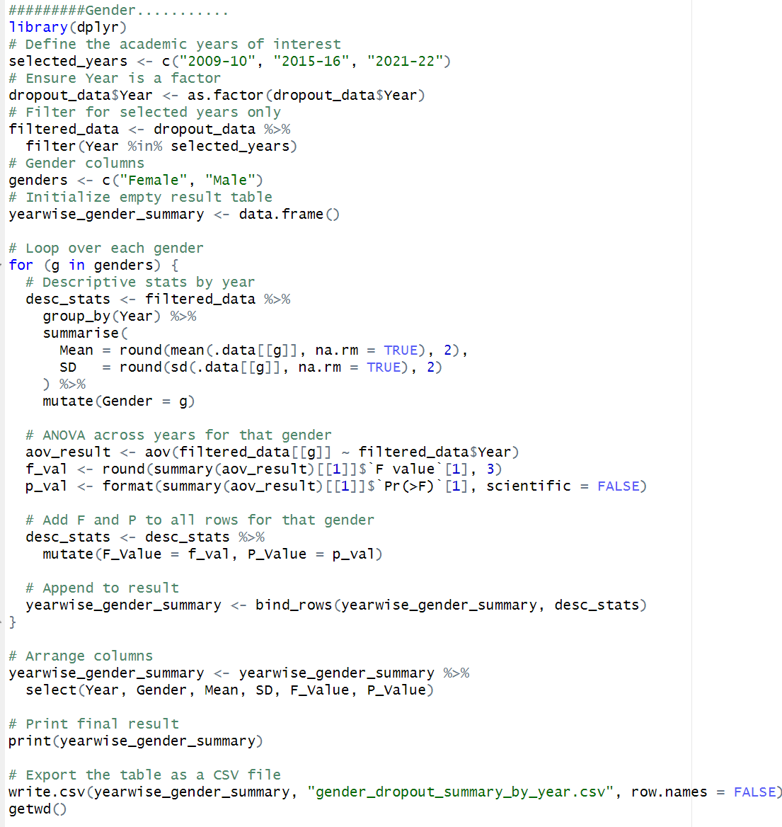
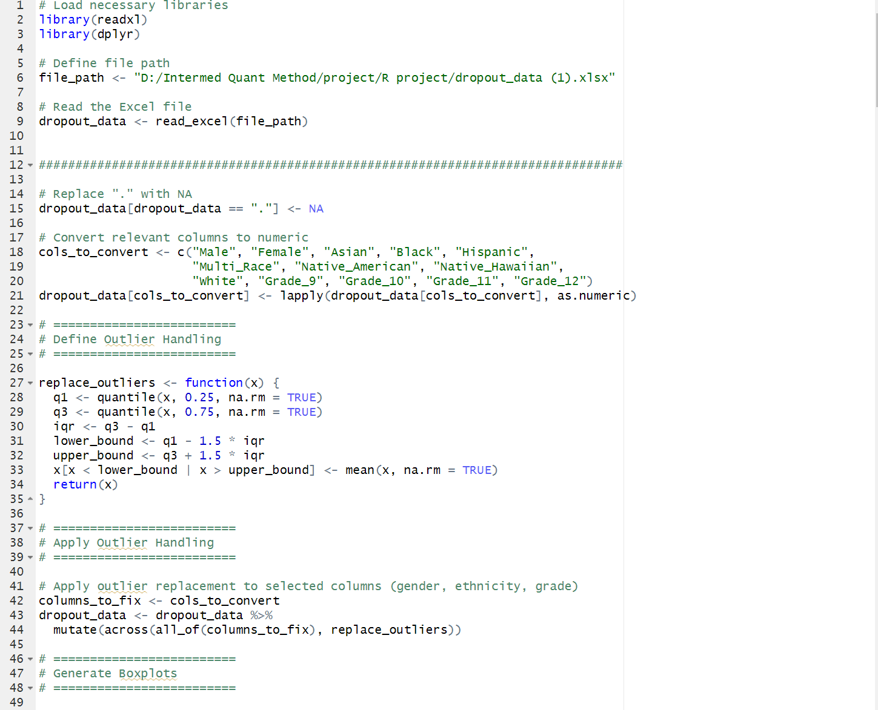
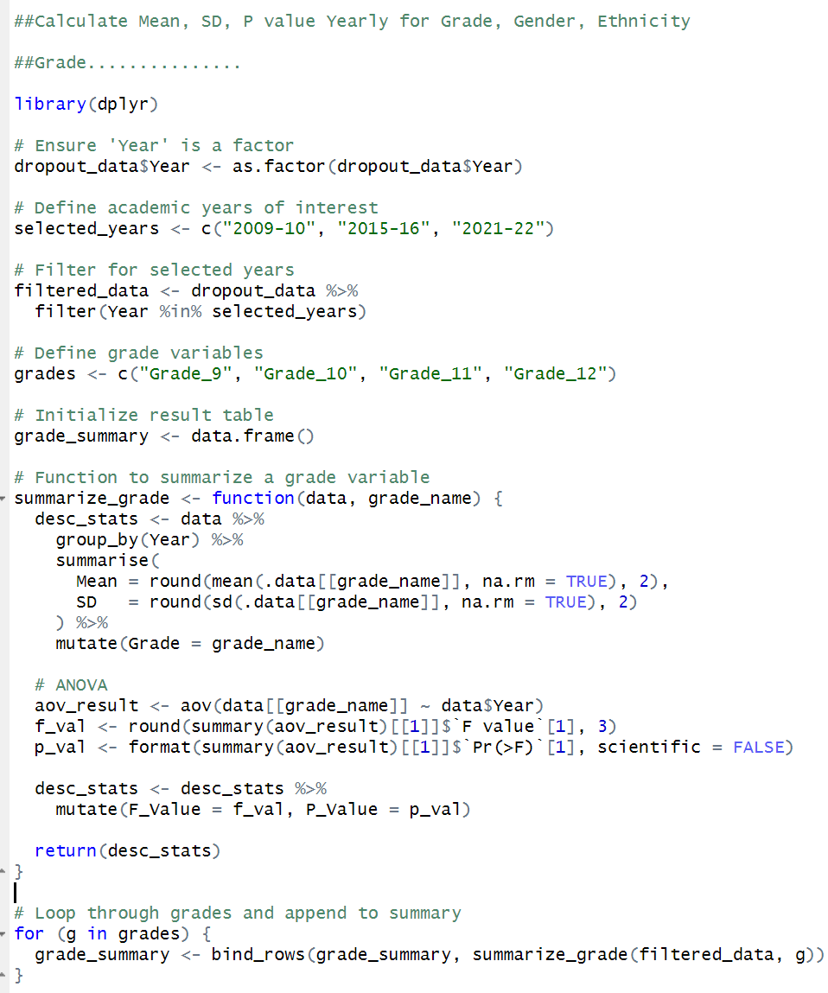
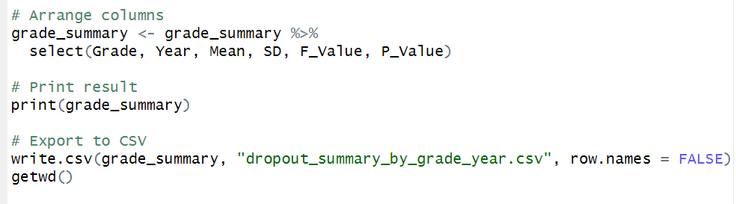
R - Code

Slide 19
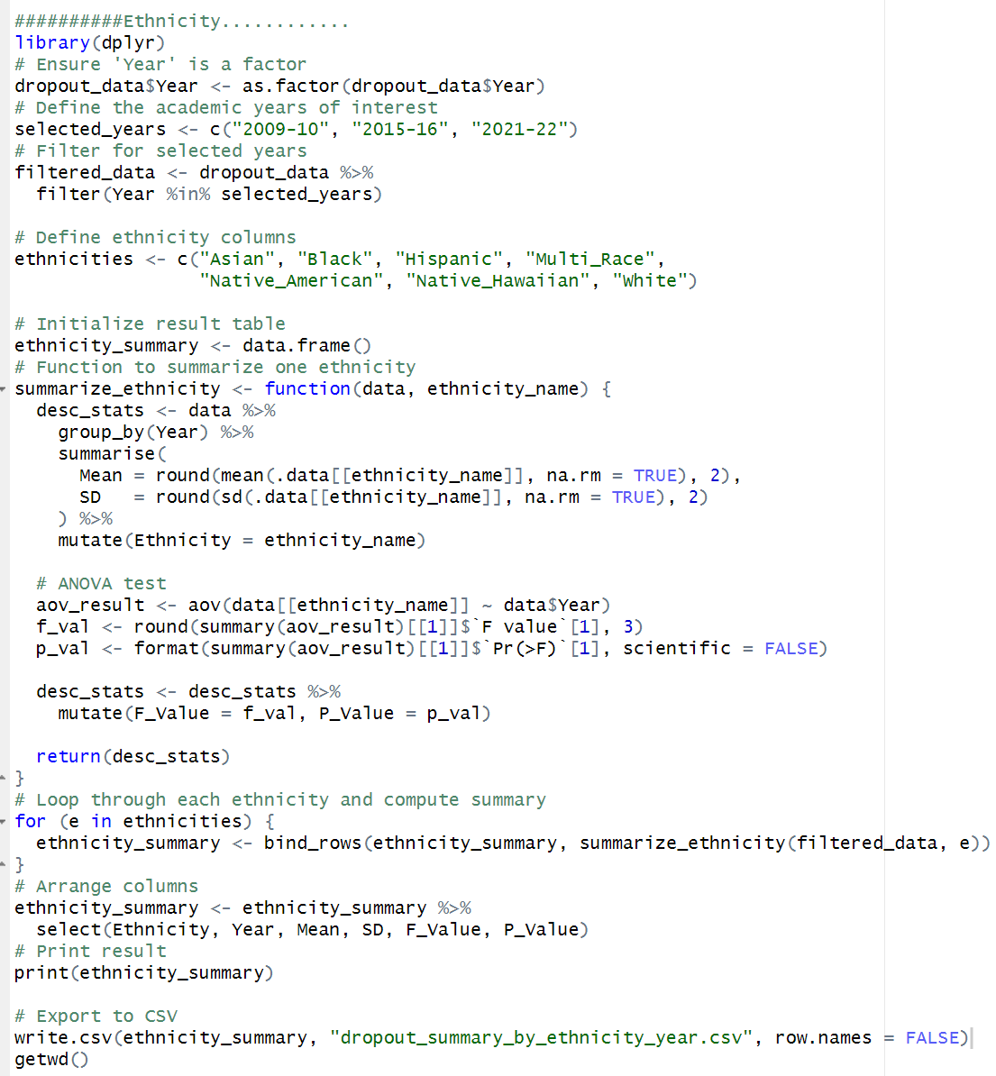
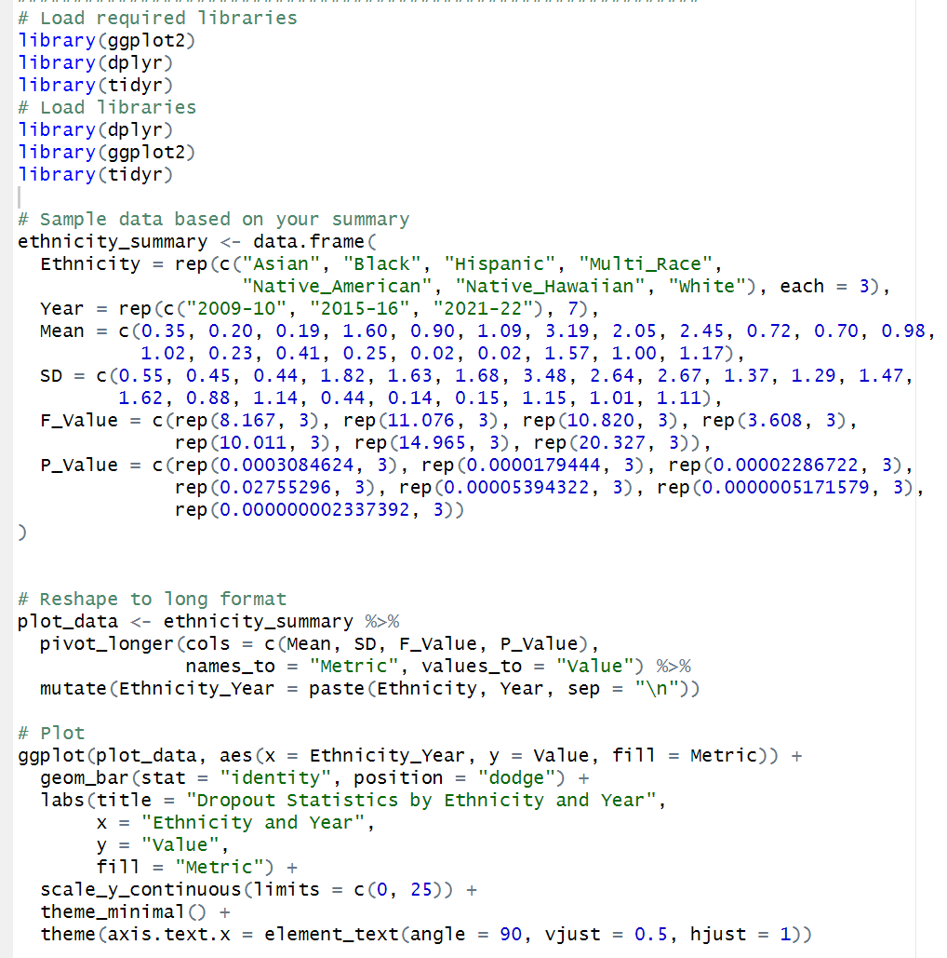

Slide 20
Thanks

