Slide 1



Mst Sanjida Alam

Slide 2
Sequence of the Presentation
Introduction
Objectives
Research Questions
Study Area
Data used
Work Flow
Result and Discussion
Conclusion
References

Slide 3
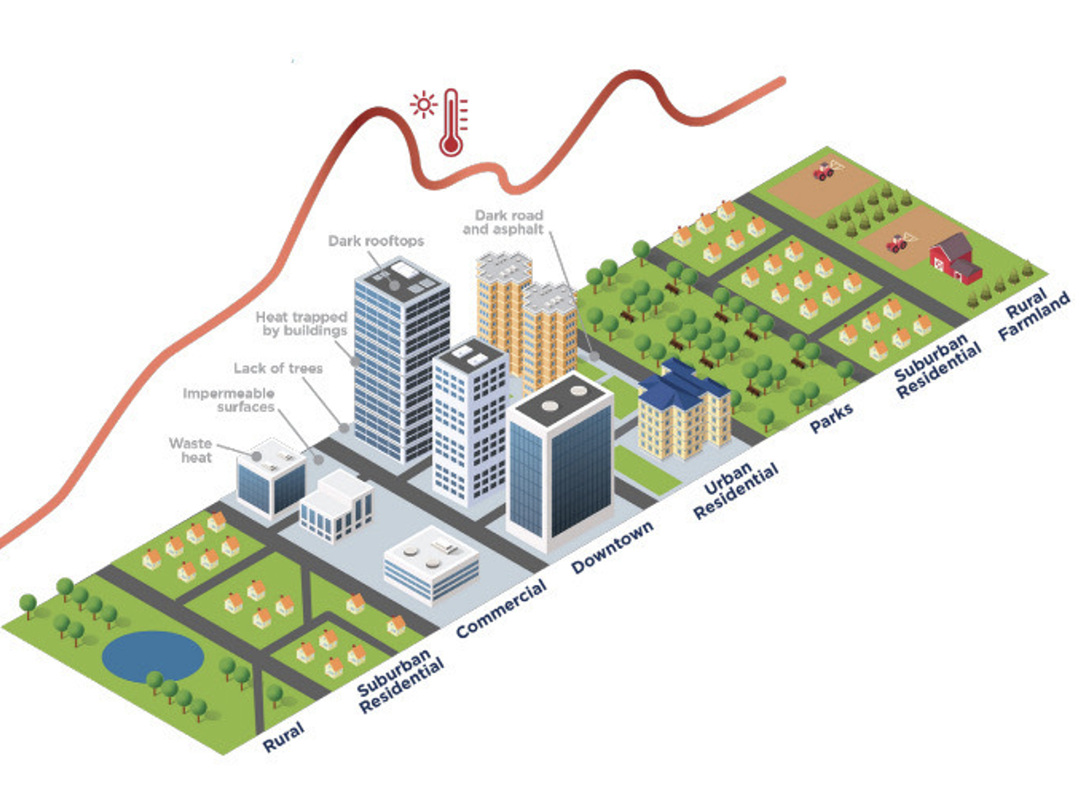
Introduction​
Rapid urbanization is a common phenomenon in the modern world.
It contributes to intensifying the effect of the Urban Heat Island (UHI) and makes the urban areas significantly hotter than the surrounding rural zones (Rahman et al., 2022).
Rising temperatures contribute to increased health risks such as heat stress, cardiovascular problems, and mortality (Ndlovu & Chungag, 2024).
Despite growth in the number of concerns, limited research exists on UHI and heat vulnerability Index (HVI) at the district level in Bangladesh. The main aim of this research is to assess UHI and HVI and its consequences in the Chattogram District of Bangladesh.

Slide 4
Objectives​
1
2
3
To assess the spatiotemporal trends of UHI from 2011 to 2024 and determine the Heat Vulnerability Index (HVI) for 2024.
To identify heat vulnerability hotspots across the study area.
To identify heat related health impacts

Slide 5
Research Questions​
?
?
?
Where are the major heat vulnerability hotspots in Chattogram District?
What are the most common health impacts are facing by the population in this study area?
Question 01
Question 02
Question 03
How the spatiotemporal pattern of the UHI has changed and what insights does the HVI provide about the population's exposure, sensitivity, and adaptive capacity to extreme heat?
?
?
?

Slide 6
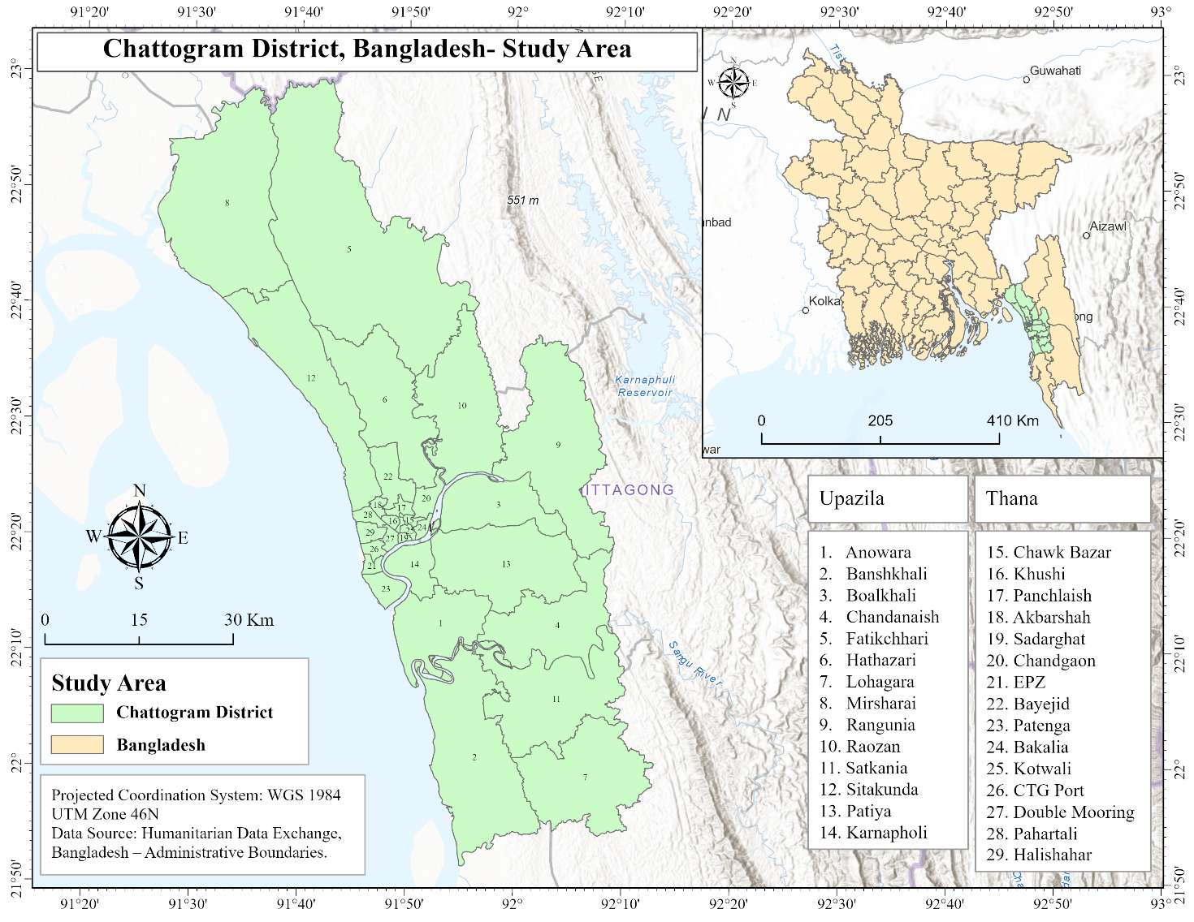
Study Area​
Chattogram district is located in the southeastern part of Bangladesh, and it is the country’s second-largest district (about 5,283 Sq km ) (BBS, 2022).
About 9.2 million people live in this district, where half of the people are located in the Chattogram City Corporation (BBS, 2022).
It is the main commercial hub of the country, and it has the largest seaport, which plays a vital role in the economic and social sectors of Bangladesh (Chowdhury, 2020).

Slide 7
Data used ​
Dataset | Source | Resolution / Scale​ | Time Period
Population Dataset including Total Population, Population Density, Female Population, Illiterate Population, Household, Kaccha Structure, Very Young Population (<14), Working Age Population (14-65), Elderly Population (>65), Pucca Structure | Population and Housing Census 2022 | Tabulate Data | 2022
Landsat 5 and Landsat 8 | USGS | Raster (30 meters ) | 2011,2015,2020,2024
Road Network | Overpass Turbo | Vector data | 2024

Slide 8
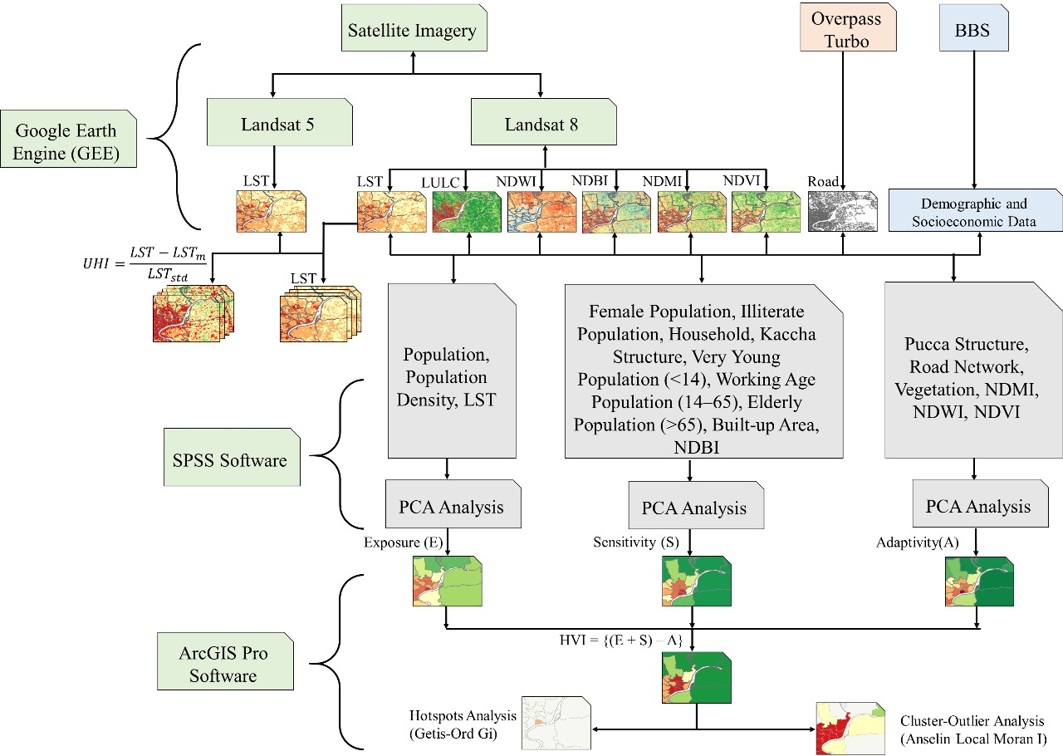
Workflow
Land Use Land Cover (LULC), Normalized Difference Moisture Index (NDMI), Normalized Difference Water Index (NDWI), Normalized Difference Vegetation Index (NDVI), Normalized Difference Built-up Index (NDBI) and LST are processed from Landsat 5 and 8 through Google Earth Engine and visualized by Arc GIS Pro.
Mean value of LST, NDBI, NDMI, NDWI, NDVI is exported from Arc GIS Pro and imported to SPSS and social and structural data were added with it for PCA analysis.
The PCA analysis results are imported to Arc GIS Pro for HVI, Hotspots Analysis and Cluster-Outlier Analysis.

Slide 9

Result​ and Discussion

Slide 10
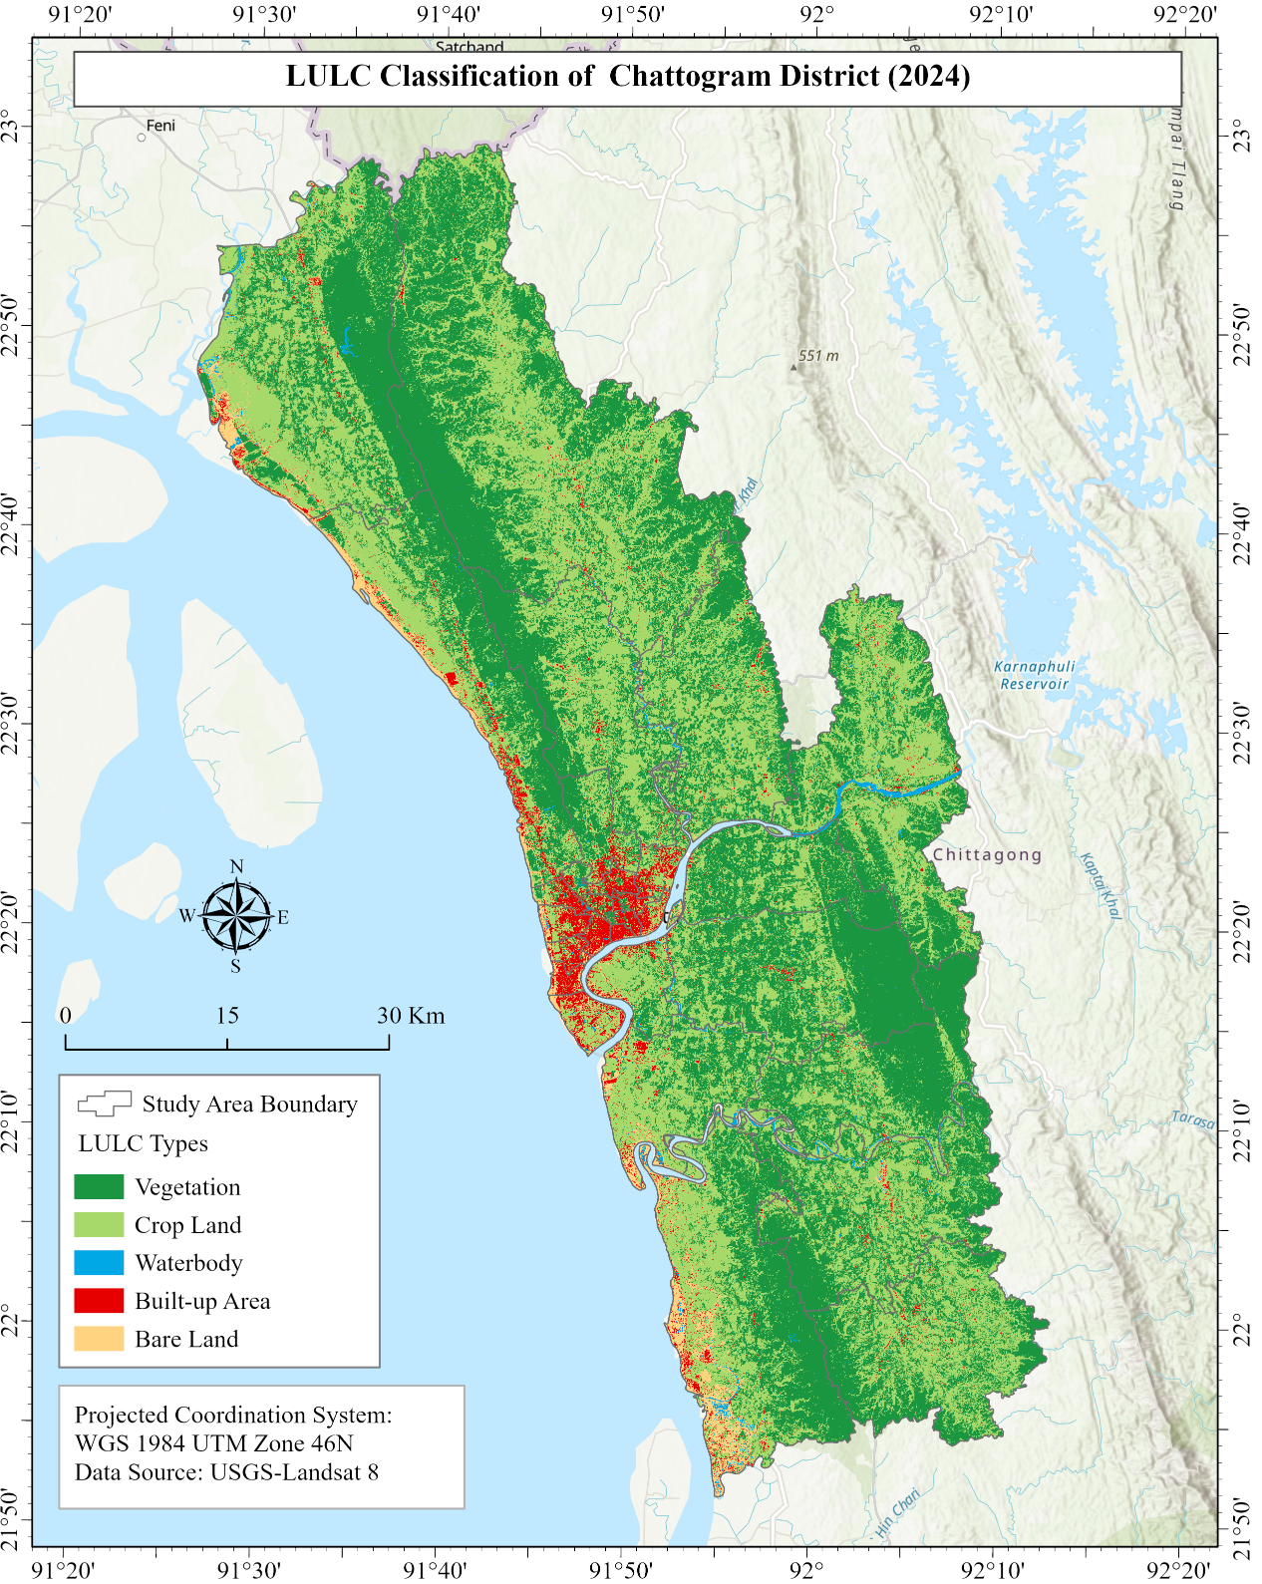
LULC Classification
Approximately 90% of the land is covered by vegetation (46.5%) and cropland (44.1%), indicating that agriculture and vegetated dominate the land.
The built-up area(3.2%) is primarily located in the southern urban center.
LULC classification had an overall accuracy of 93% and a Kappa coefficient of 90%, confirming the reliability of the results.
Calculation of the area of different LULC classes
LULC Types | Area (km²) | Area (%)
Vegetation | 2069.32 | 46.493455
Cropland | 1960.797 | 44.055162
Waterbody | 28.01 | 0.6293283
Built-up Area | 143.23 | 3.2180898
Bare Land | 249.42 | 5.6039653

Slide 11
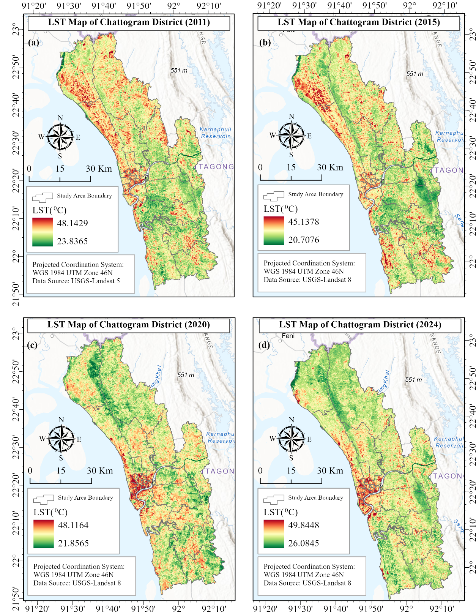
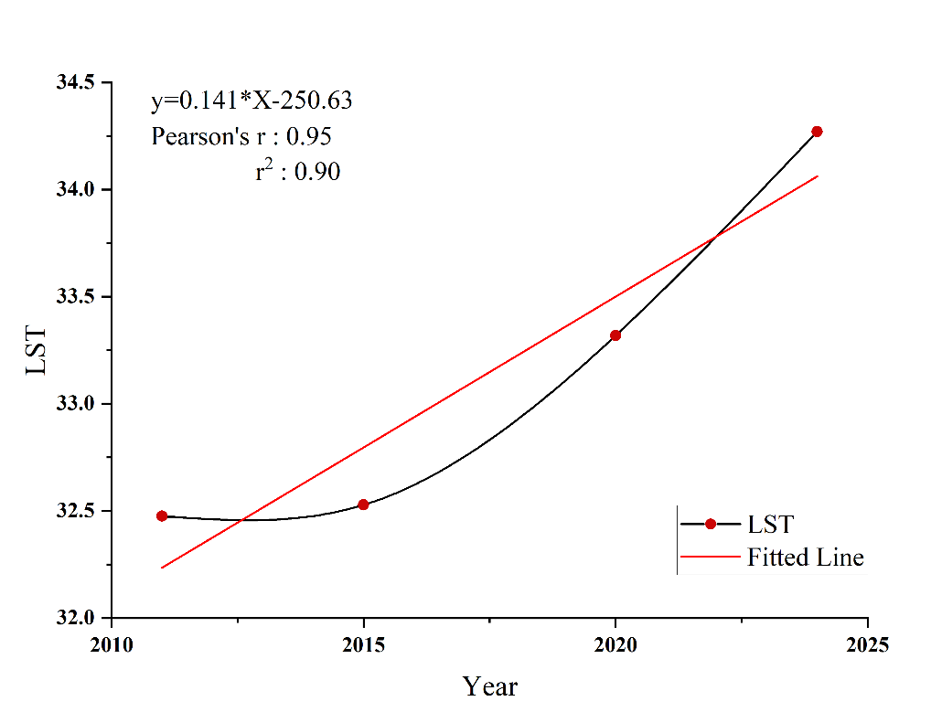
Land Surface Temperature (2011 to 2024)
The average LST rose from 32.48°C (2011) to 34.27°C (2024), which indicates the increase of 1.8 °C in 13 years.
The highest LST was observed in the Sadarghat Thana (urban core)​
The lowest LST was observed in the Fatikchhari Union (vegetated rural area).
Statistical evidence (r=0.95, r²=0.90) indicated that LST changes with time.

Slide 12
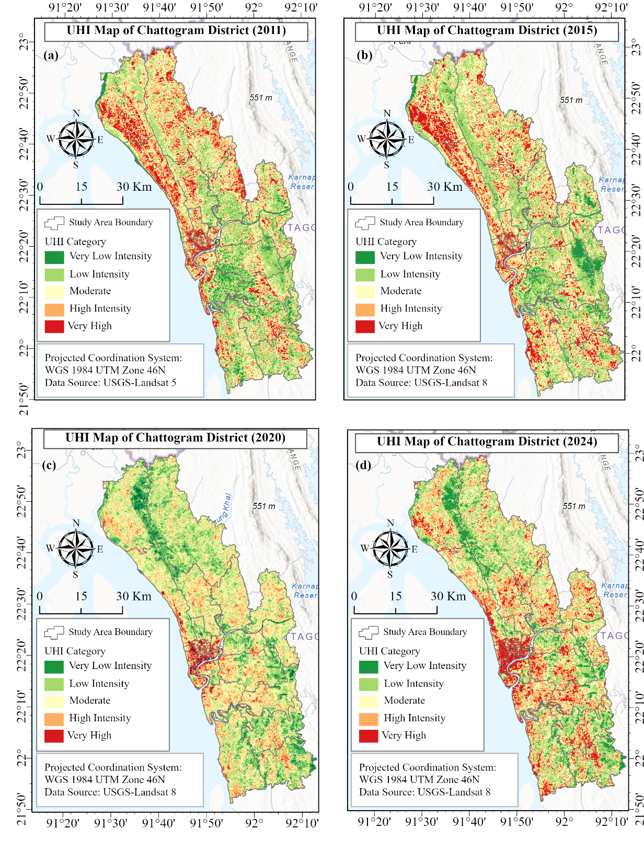
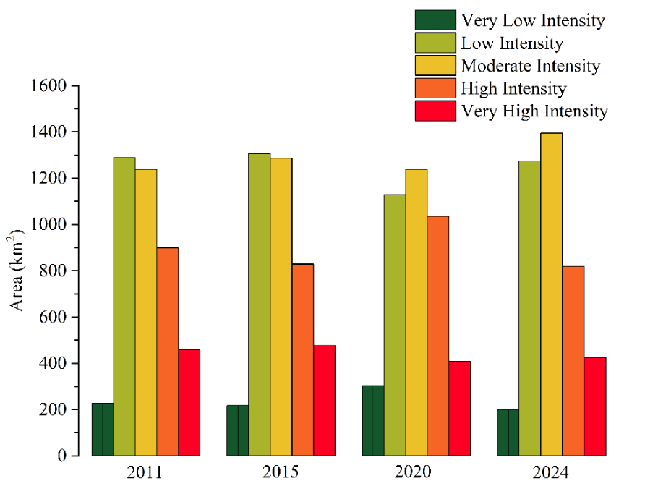
UHI Intensity ( 2011 to 2024)
The UHI patterns were changed and dispersed with time.
Low and moderate UHI zones dominated in 2011, but by 2015, very high UHI areas expanded (477.04 km²).
The moderate zones expanded and became the most widespread (1,394.98 km²) in 2024.
Mostly higher UHI was observed in the central Chattogram City.

Slide 13
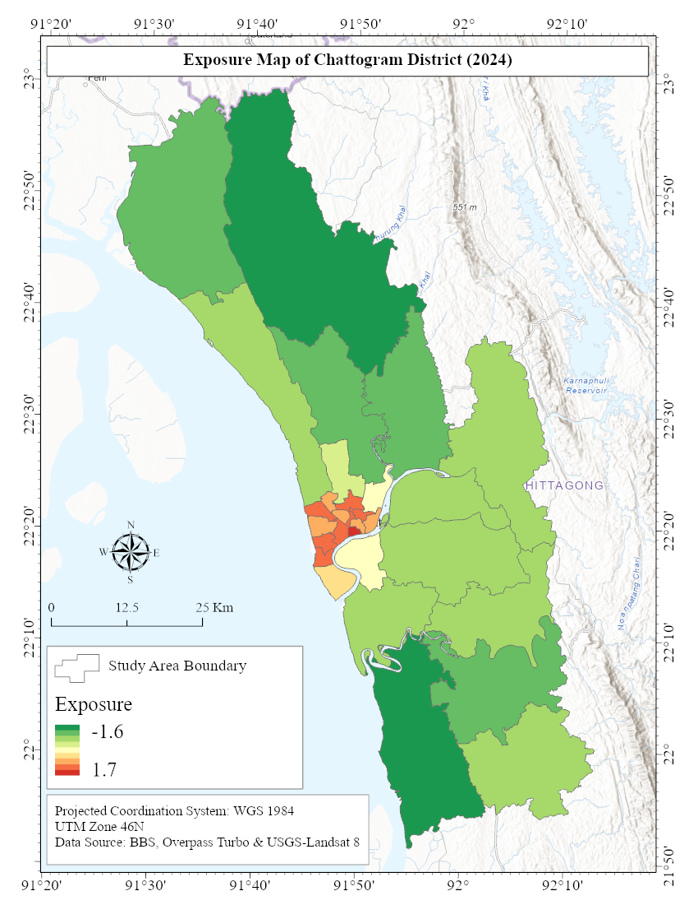
Exposure to Heat Events (2024)
The KMO index (0.71) showed data were suited for PCA analysis. PCA extracted one dominant component (eigenvalue 2.52) where two variable has given more importance such as population density and LST that explained 84.15% of the total variance.
Sadarghat Thana is the most exposed to heat events and most of the Thanas of the city corporation are highly exposed to heat.
This component showed positive correlation with LST and population density, but negative correlation with total population.

Slide 14
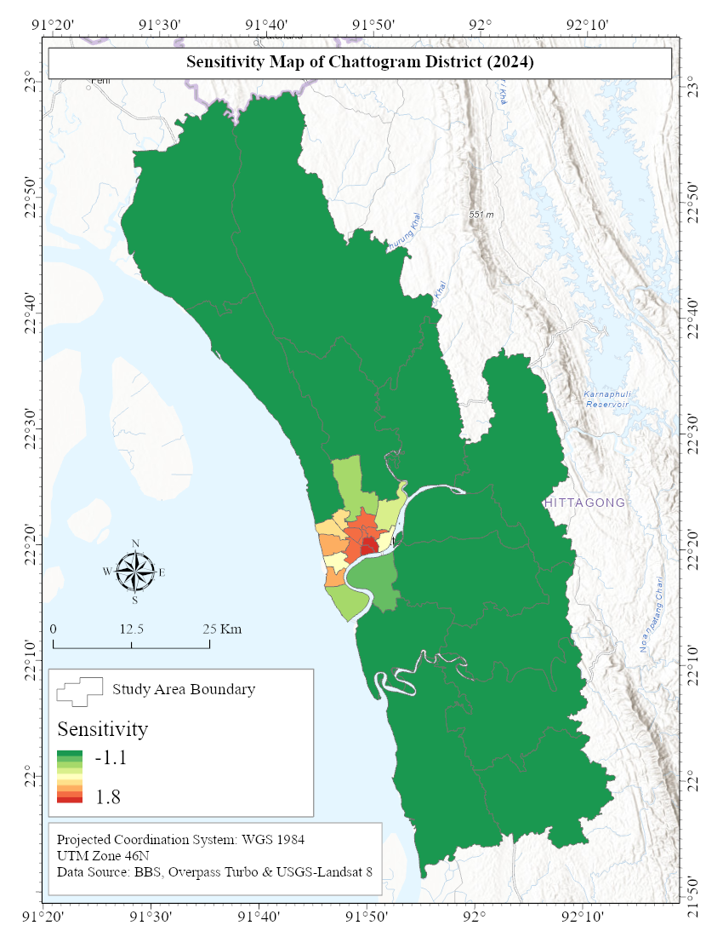
Sensitivity to Heat Events (2024)
The KMO index (0. 78) showed data were suited for PCA analysis. PCA extracted one dominant component (eigenvalue 7.514) where female population, household number, very young population, working age population, build up area, and NDVI contribute most strongly that explained 83.49% of the total variance.
Sadarghat and Kotwali Thanas are the most sensitive to heat events and most of the Thanas of the city corporation are highly sensitive to heat.

Slide 15
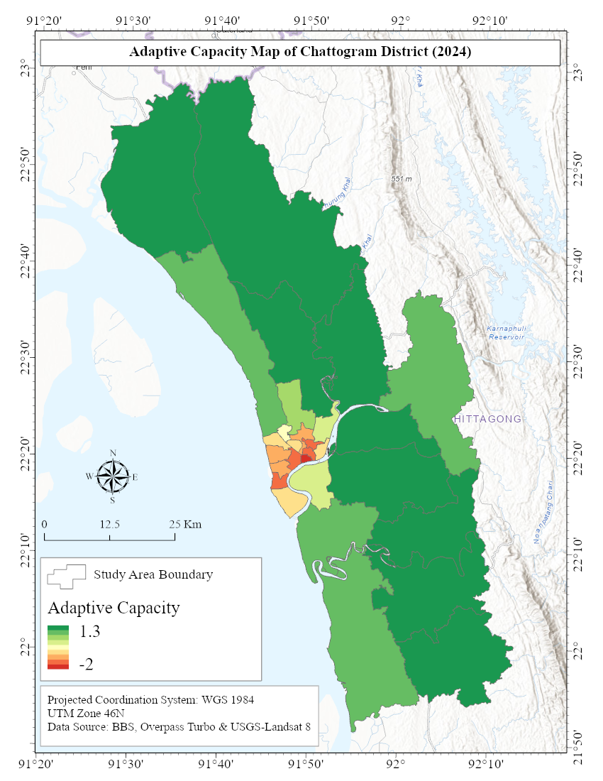
Adaptive Capacity to Heat Events (2024)
The KMO index (0.81) showed data were suited for PCA analysis. PCA extracted one dominant component (eigenvalue 5.3) where the most influential variables are vegetation, NDVI and NDMI that explained 88.67% of the total variance.
Sadarghat Thana has the lowest adaptive capacity to heat events and the city corporation’s other Thanas show different levels of capacity but maximum have low capacity to heat events.
The most influential factors were NDMI, NDVI, (positive) and NDWI, road density (negative).

Slide 16
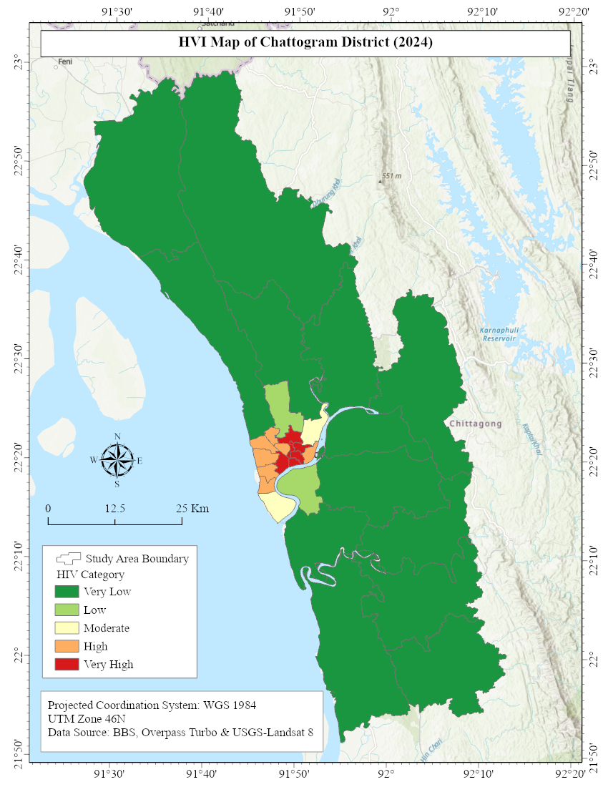
Heat Vulnerability Index (HVI)
Over 94% of the area showed very low vulnerability, while only 0.8% was very highly vulnerable.
Very high vulnerable zones: Double Mooring, Sadarghat, Kotwali, Chawk Bazar, and Panchlaish.
Area calculation of HVI category
HVI Categories | Area (Km²) | Area (%)
Very Low Risk Zone | 4196.597 | 94.42598
Low Risk Zone | 101.1616 | 2.276197
Moderate Risk Zone | 46.14753 | 1.038348
High-Risk Zone | 64.89083 | 1.460083
Very High-Risk Zone | 35.52747 | 0.79939

Slide 17
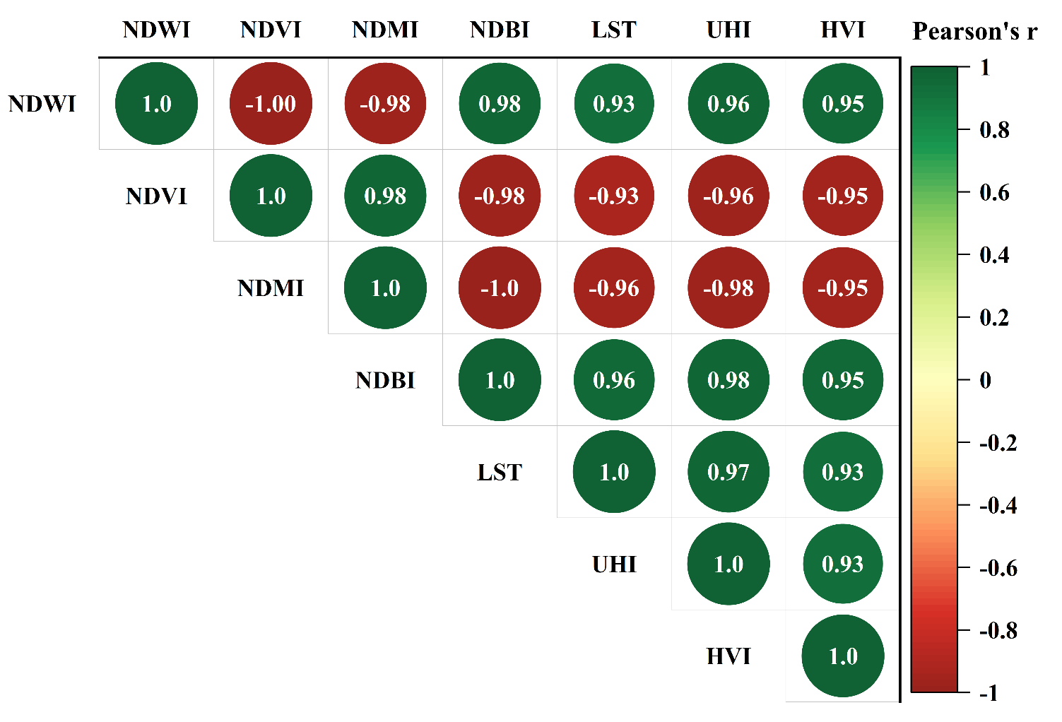
Correlation of NDVI, NDBI, NDMI, and NDWI with UHI and HVI
NDVI (-0.96) and NDMI (-0.98) are significantly and negatively correlated with UHI which means less vegetation and moisture make people more susceptible to heat.
There is a positive correlation between NDBI (0.98) and NDWI (0.96) with UHI, indicating that more built-up areas and this study was carried out during the dry season, water body coverage was low which explains its positive correlation with HVI.
Increased vegetation and moisture decrease land surface temperature (LST) and HVI, whereas urbanization increases the effects of UHI.

Slide 18
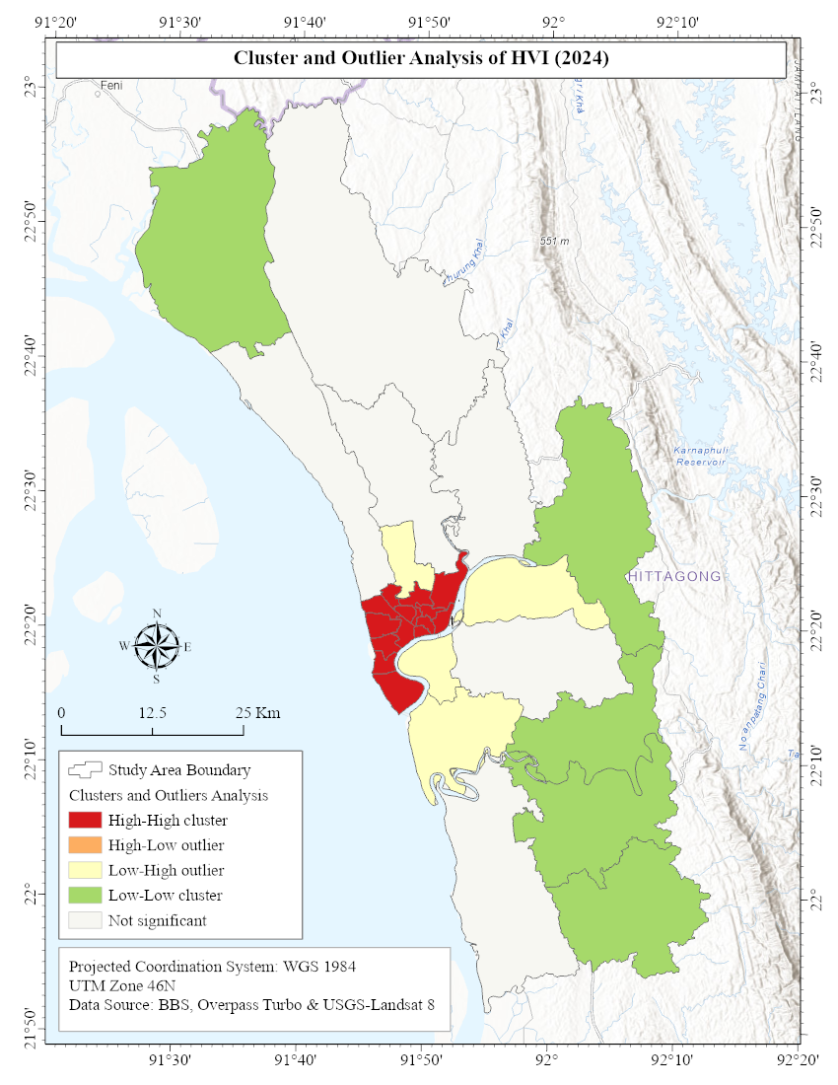
Cluster-Outlier Analysis
High-High (HH) Clusters (Red): Found in 14 thanas situated at the city center, these areas indicate high heat vulnerability, with increasing UHI effects.
Low-Low (LL) Clusters (Green): Found in peri-urban and rural upazilas include Satkania, Rangunia, Mirsharai, Chandanaish, and Lohagara, which are characterized by low vulnerability due to the presence of vegetation, croplands, and low population density.
This analysis indicates a clustered pattern of heat risk (Moran’s I=0.51, z=5.12, p<0.001), where urban areas are the hotspots and rural areas are the safer zones.

Slide 19
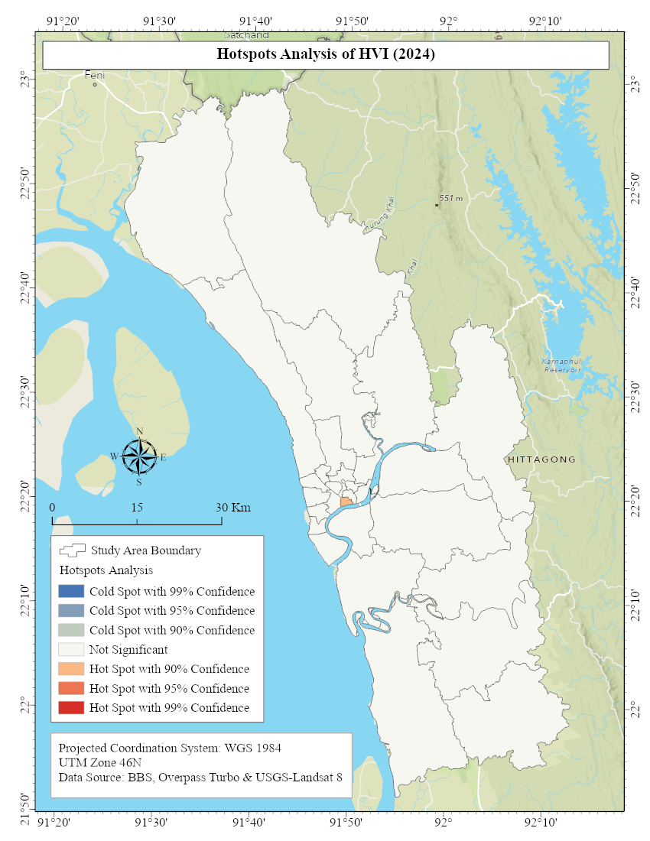
Hotspot Analysis
Hotspot (Red): Sadarghat Thana was the only statistically significant hotspot, and it was highly vulnerable to heat because of the high population density, urbanization, and extremely low adaptive capacity.
Coldspot (Blue): None of the cold spots were found to be statistically significant, thus there was no area that would be distinctly low-risk.
The hotspot analysis identifies Sadarghat as the most vulnerable area to work with and other areas have different levels of vulnerability without creating coldspot clusters.

Slide 20
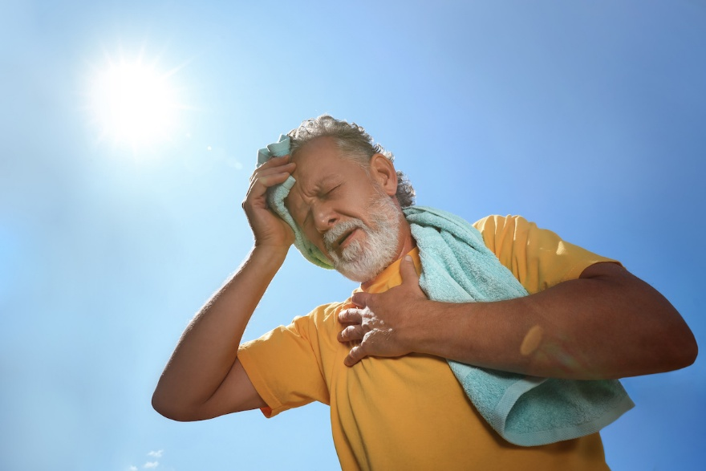
UHI and HVI Impacts on Public Health
Heat events cause serious health problems such as heat exhaustion, heatstroke, dehydration, and worsening of cardiovascular and respiratory conditions, leading to higher mortality.
Children and the elderly are most vulnerable because they have limited ability to regulate body temperature (Shamim, 2024).
Previous study found that about 20% death rate increased due to heat events in Bangladesh (Mannan et al.,2022).
Past heatwaves in Bangladesh caused many deaths, including 3,800 in 2005 and 62 in 2003 (Arrighi et al., 2017 and Rajib et al., 2011).
News media reported 13 heatstroke-related deaths in Chattogram in 2024.
This study observed that approximately 22.2 percent elder (>65) and 20.2 percent children (<14) health are most vulnerable in the CTG District in response to UHI.

Slide 21

Limitation
Due to the limited availability of the dataset, this study could not incorporate high-resolution and primary health-related data.
Analysis was based only on summer imagery, but night-time and seasonal UHI patterns were not captured.

Slide 22
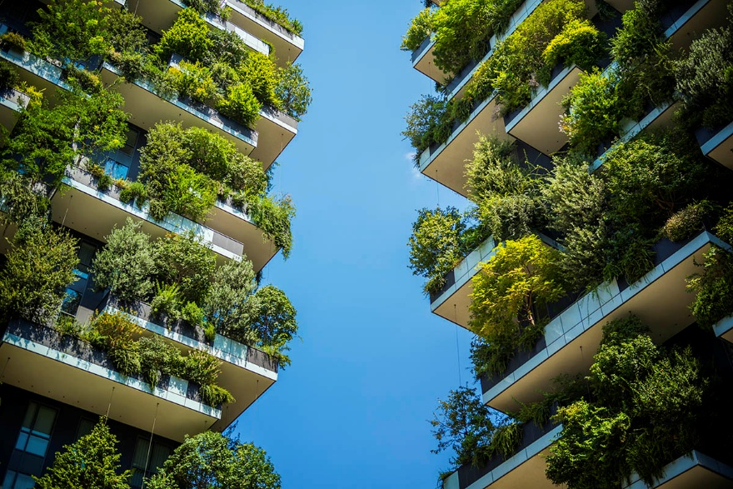
Conclusion
The average LST rose in Chattogram was +1.8°C (2011-2024), and the hotspots were found in the dense urban cores.
The HVI indicates that there is a low risk in most areas, and very high levels of vulnerability in urban centers (Sadarghat, Kotwali, Double Mooring, Panchlaish).
Findings reveal the urgency of the need to incorporate UHI and HVI evaluation into urban planning, greening plans, as well as into public health adaptation policies.

Slide 23
References
Arrighi, J., Burkart, K., & Nissan, H. (2017, December). Raising awareness on heat related mortality in Bangladesh. In AGU Fall Meeting Abstracts (Vol. 2017, pp. PA12A-06).
BBS. (2022). Population and housing census 2022: Chattogram Report. Bangladesh Bureau of Statistics, Statistics and Informatics Division, Ministry of Planning, Government of the People’s Republic of Bangladesh.
Chowdhury, M. M. H. (2020). Selection of dry port location in the hinterland of Chattogram Port: a fuzzy AHP-BWM-PROMETHEE approach.
Mannan, M. A., Akter, F., Rashid, M. B., Hossain, M. M., Faruque, S. O., Ara, S. S., ... & Chowdhury, M. A. M. (2022). An analytical study of Heat Wave occurred over Bangladesh during pre-monsoon of 2021. Dew-drop, 8, 152-160.
Ndlovu, N., & Chungag, B. N. (2024). Impact of heat stress on cardiovascular health outcomes of older adults: A mini review. Aging and Health Research, 4(2), 100189.
Rahman, M. N., Rony, M. R. H., Jannat, F. A., Chandra Pal, S., Islam, M. S., Alam, E., & Islam, A. R. M. T. (2022). Impact of urbanization on urban heat island intensity in major districts of Bangladesh using remote sensing and geo-spatial tools. Climate, 10(1), 3.
Rajib, M. A., Mortuza, M. R., Selmi, S., Ankur, A. K., & Rahman, M. M. (2011). Increase of heat index over Bangladesh: impact of climate change. Change, 2010(33.470C), 32-280C.
Shamim, Md. M. I. (2024). Impact of Recent Heat Wave on Public Health in Bangladesh. Global Mainstream Journal, 1(1), 1–7. https://doi.org/10.62304/ijhm.v1i1.119

Slide 24
Acknowledgement
This research was supported by the GREENS research group. The author gratefully acknowledges their support throughout this research.

Slide 25


